Slide 1
2025-2026 Course Matrix Updates
February 17, 2025

Slide 2
Audience
Program Managers
Vice Chair
Coordinators
Common Econ-Help Questions

Slide 3
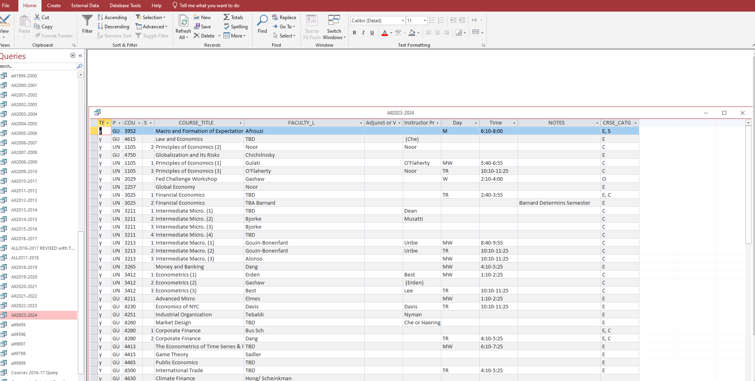
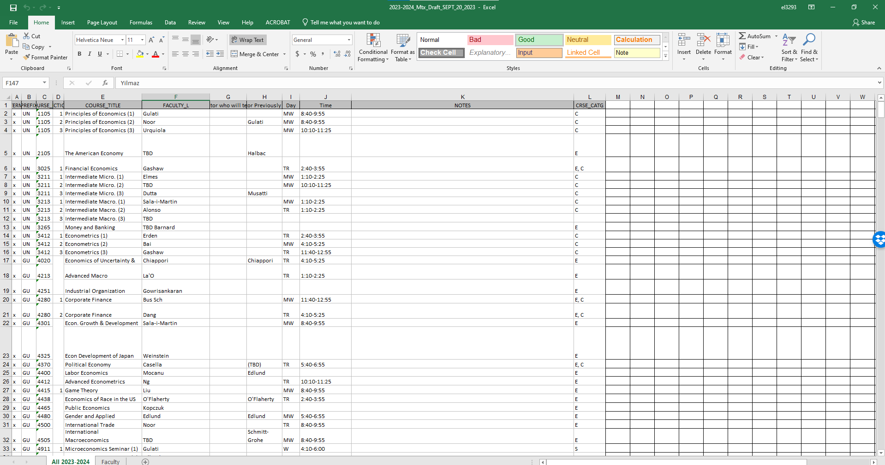
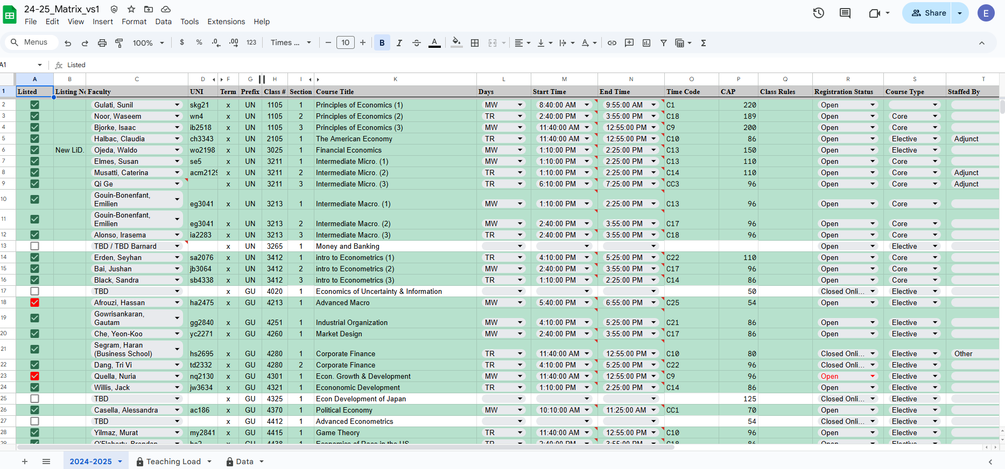
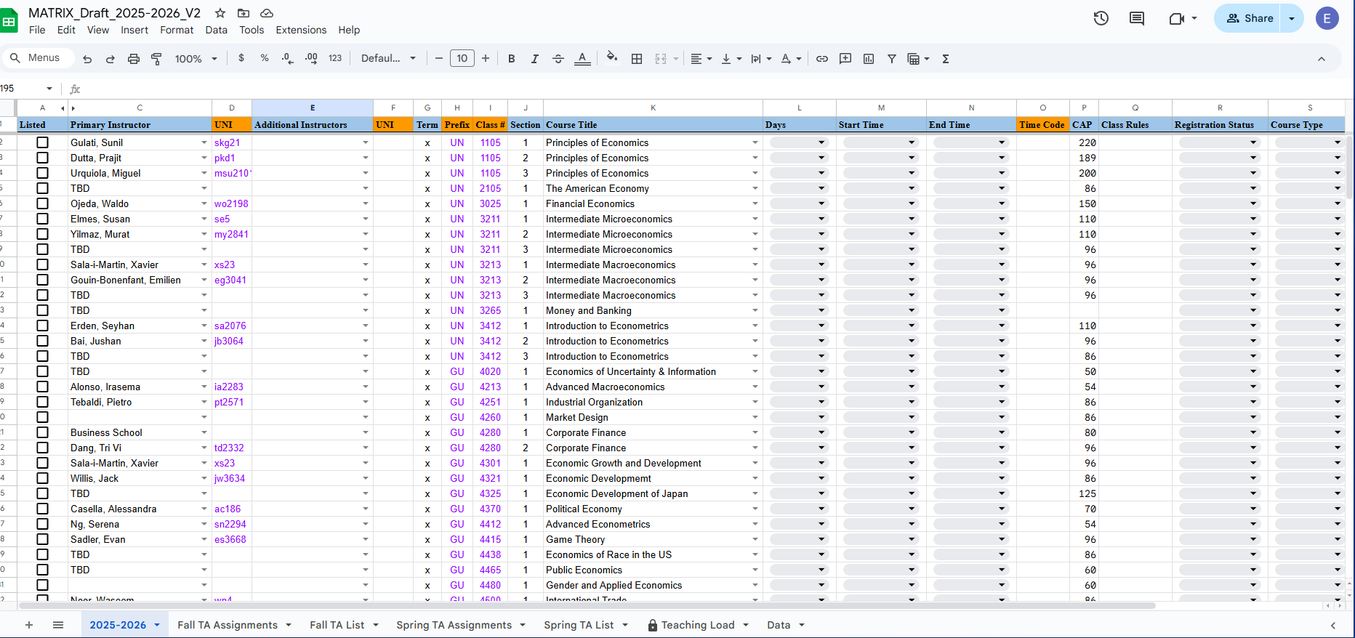
Objective
The Matrix has evolved through many iterations, each update bringing us closer to a more efficient and valuable system. Its true strength lies in the collective effort of everyone who contributes to keeping the information current.

Slide 4
Updated Features
Adding Instructor(s)
Auto-Populates Information
Teaching Assignments
TA Assignments
Auto-Notifications
Data Collection for Next Version

Slide 5
Procedure

Slide 6
Teaching Assignments (Vice Chair) & Faculty Notifications
Manager’s and Coordinators
Information then entered into Course Management
Prior to Sharing
Data
Updates
Scheduling
CM
Once the information is entered into the “Teaching Load” tab it is transferred to the Main Tab
Updates and Scheduling are started.

Slide 7
Accuracy
One of the key benefits of the Matrix is that it provides a final, comprehensive record of each course, including its settings and instructors. As we enter and update information, the Matrix serves as the definitive source, ensuring everyone is aligned on what is set. Every update matters—details like room assignments or enrollment caps can make a significant difference in the long run.

Slide 8
Your recommendations matter
Your input matters because every detail you add or update helps create a more streamlined and accurate system. When developing and improving systems, even small contributions can save time and effort for everyone. Each update reduces confusion, eliminates extra steps, and ensures that the information we rely on is clear and reliable.

Slide 9
Step by Step Guide

Slide 10
Column Headings (“2025-2026” Tab)
Instructor(s)
Course Title
Days, Start Time, End Time,
CAP
Registration Status
Course Type
Staffed By
Room Assignment
Listed

Slide 11
Enrollment Status
Enrollment Status
Enrollment Status established whether and how students may register for classes. These options can be modified throughout the registration period.
Open for Enrollment (auto-fill Wait List)
By default, classes are open to enrollment. Eligible students can register until the cap is reached after which a waitlist will be activated. Students from the waitlist will be enrolled in chronological order if and when enrolled students drop the course.
Registration Block (no Adds, self-managed waitlist)
Instructors and departments that wish to manually admit students in SSOL from a waitlist can select Registration Block. All students must join a waitlist prior to being admitted into the course. Students can still drop the course during any active registration window.
Closed for Online Registration (no Adds or Drops)
Closing a section for online registration is only useful when students should not be able to drop a course. There are limited use cases for this option since the majority of sections should allow students to drop a course.
Wait List Status, Wait List Type, and Wait List Deactivation Date are new fields that will be referenced in the new Vergil Registration and Enrollment platform.

Slide 12
TA List & Assignments
Name
UNI
Course Information
Instructor
TA Assigned - Multiple Selection Field
Send Recitation Scheduling Notification

Slide 13
Data Tab
The Data tab is where you can update consistent information such as instructor names and UNIs, as well as course titles and numbers. This data serves as the foundation for the spreadsheet and automatically populates certain fields. Any changes to this information should only be made after notifying the spreadsheet owner.

Slide 14
Thank you for attending this training! Your participation and engagement are truly appreciated. I hope the session provided valuable insights and helped you feel more confident in using the system. Your contributions make a difference, and we appreciate your effort in keeping everything accurate and up to date. If you have any questions, don’t hesitate to reach out. Thanks again!

