Slide 1
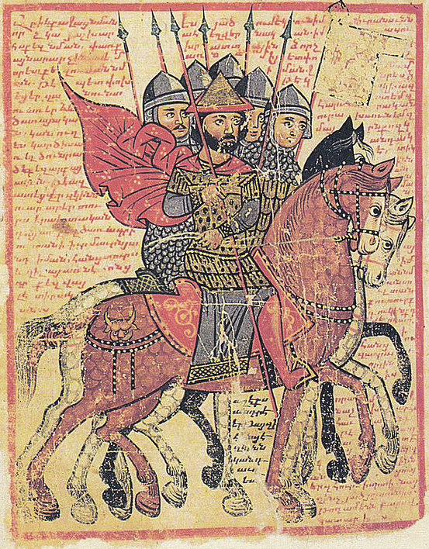
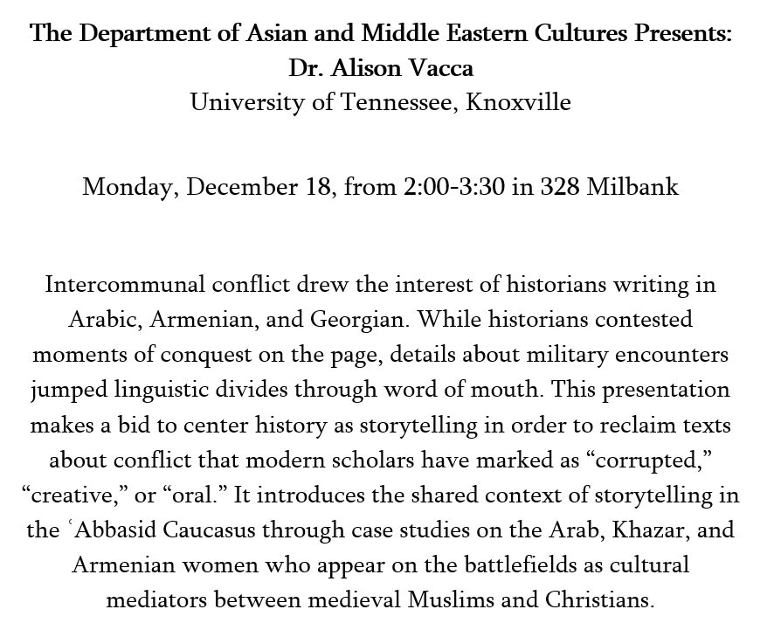
Conflict in the Medieval Caucasus

Slide 2
Conflict in the Medieval Caucasus
The Department of Asian and Middle Eastern Cultures Presents:
Dr. Alison Vacca
University of Tennessee, Knoxville
Monday, December 18
from 2:00-3:30
328 Milbank

