Slide 1
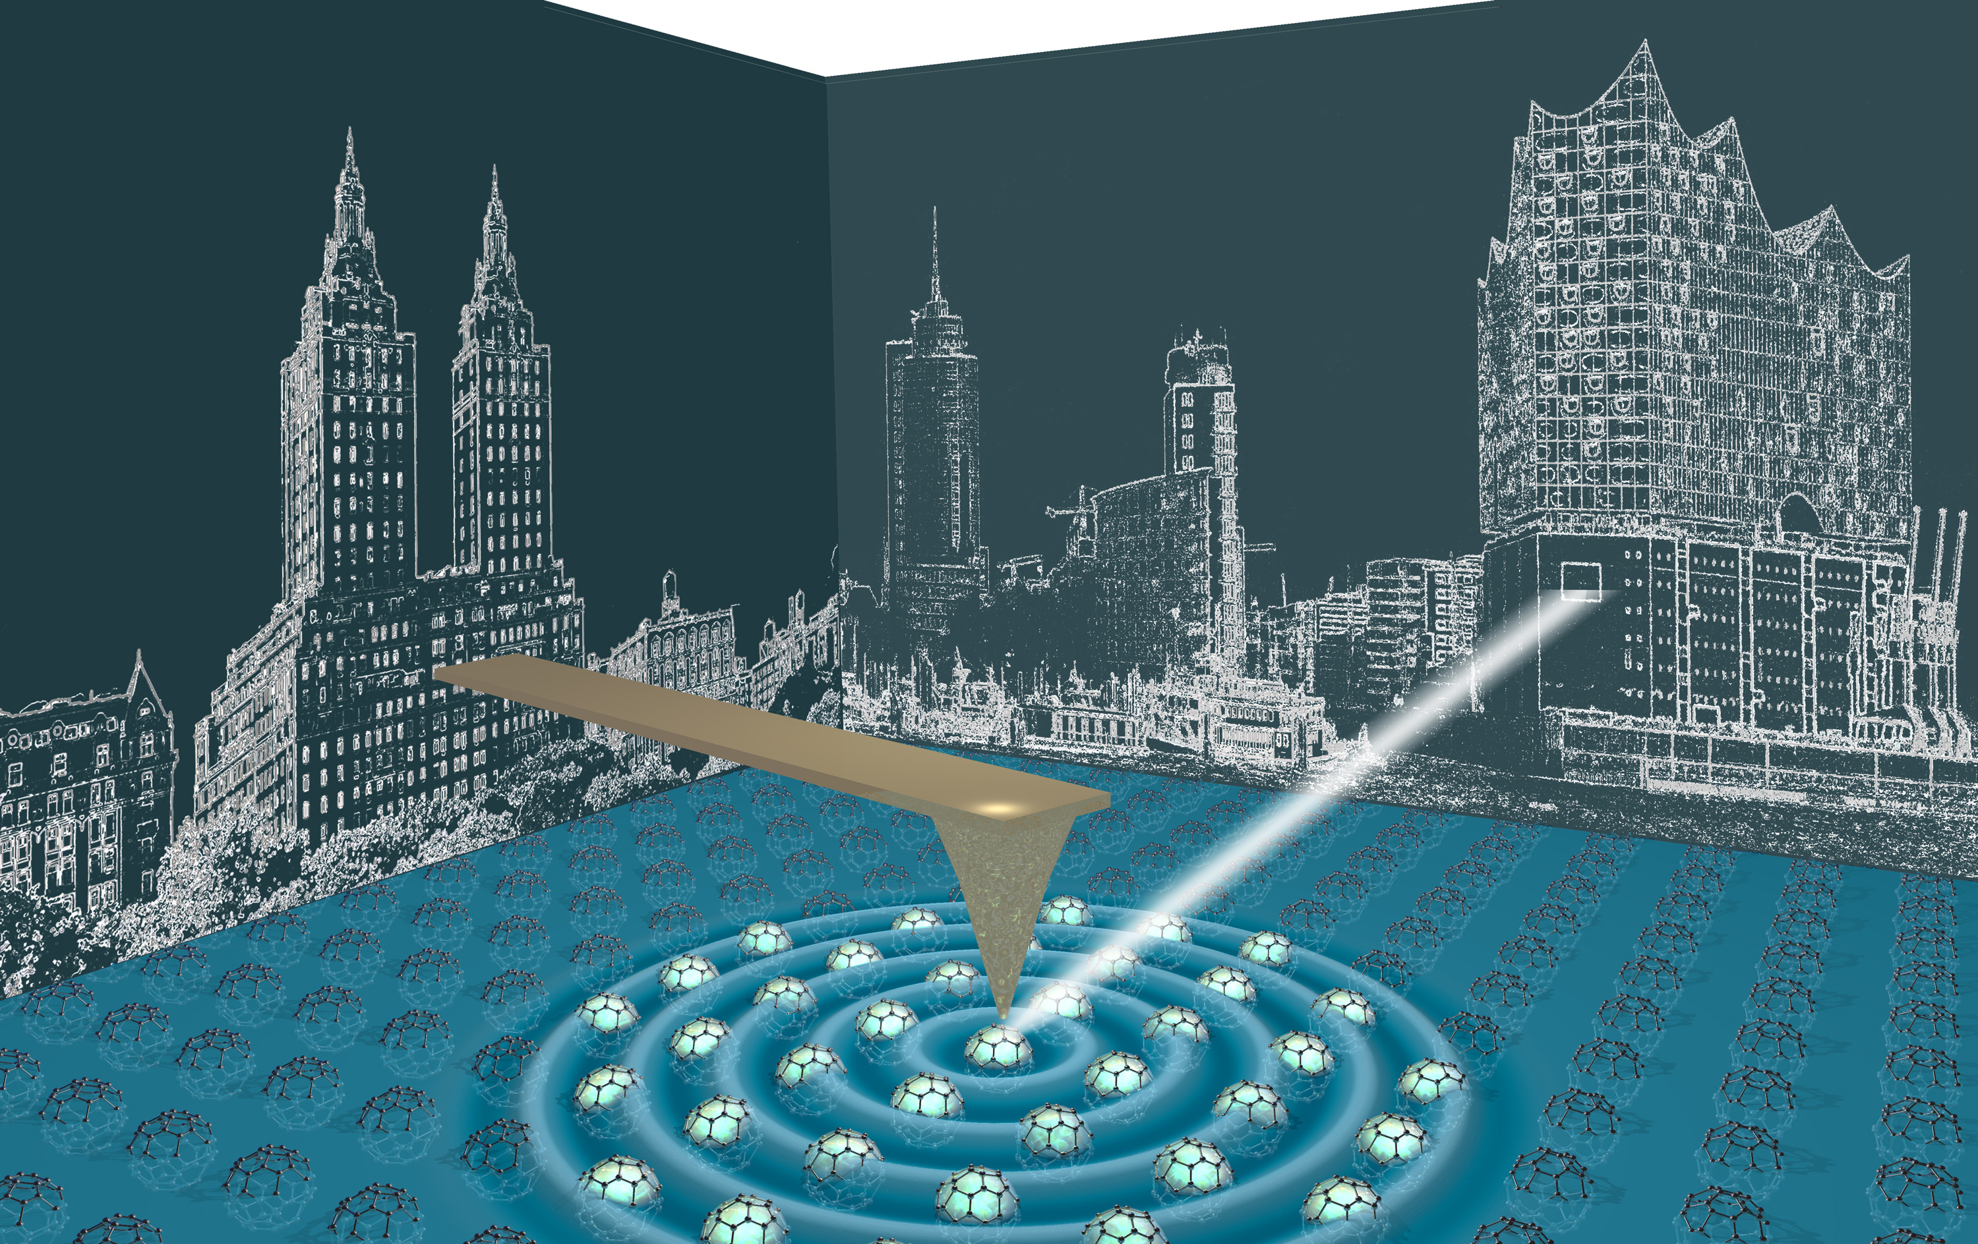
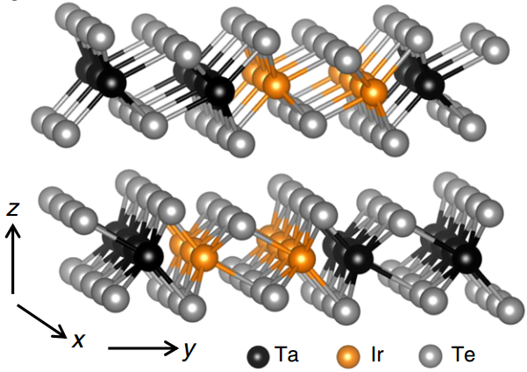
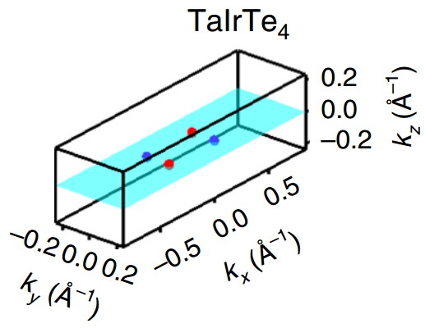
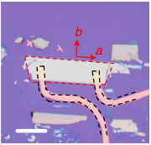
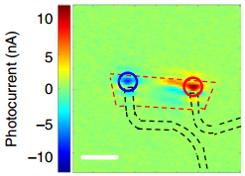
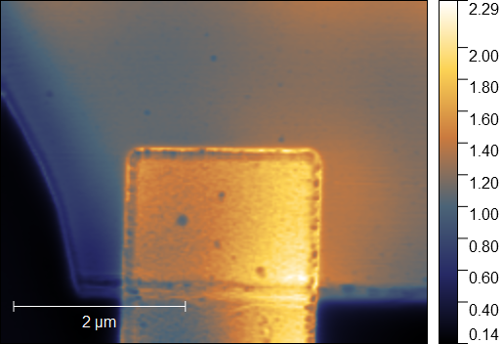
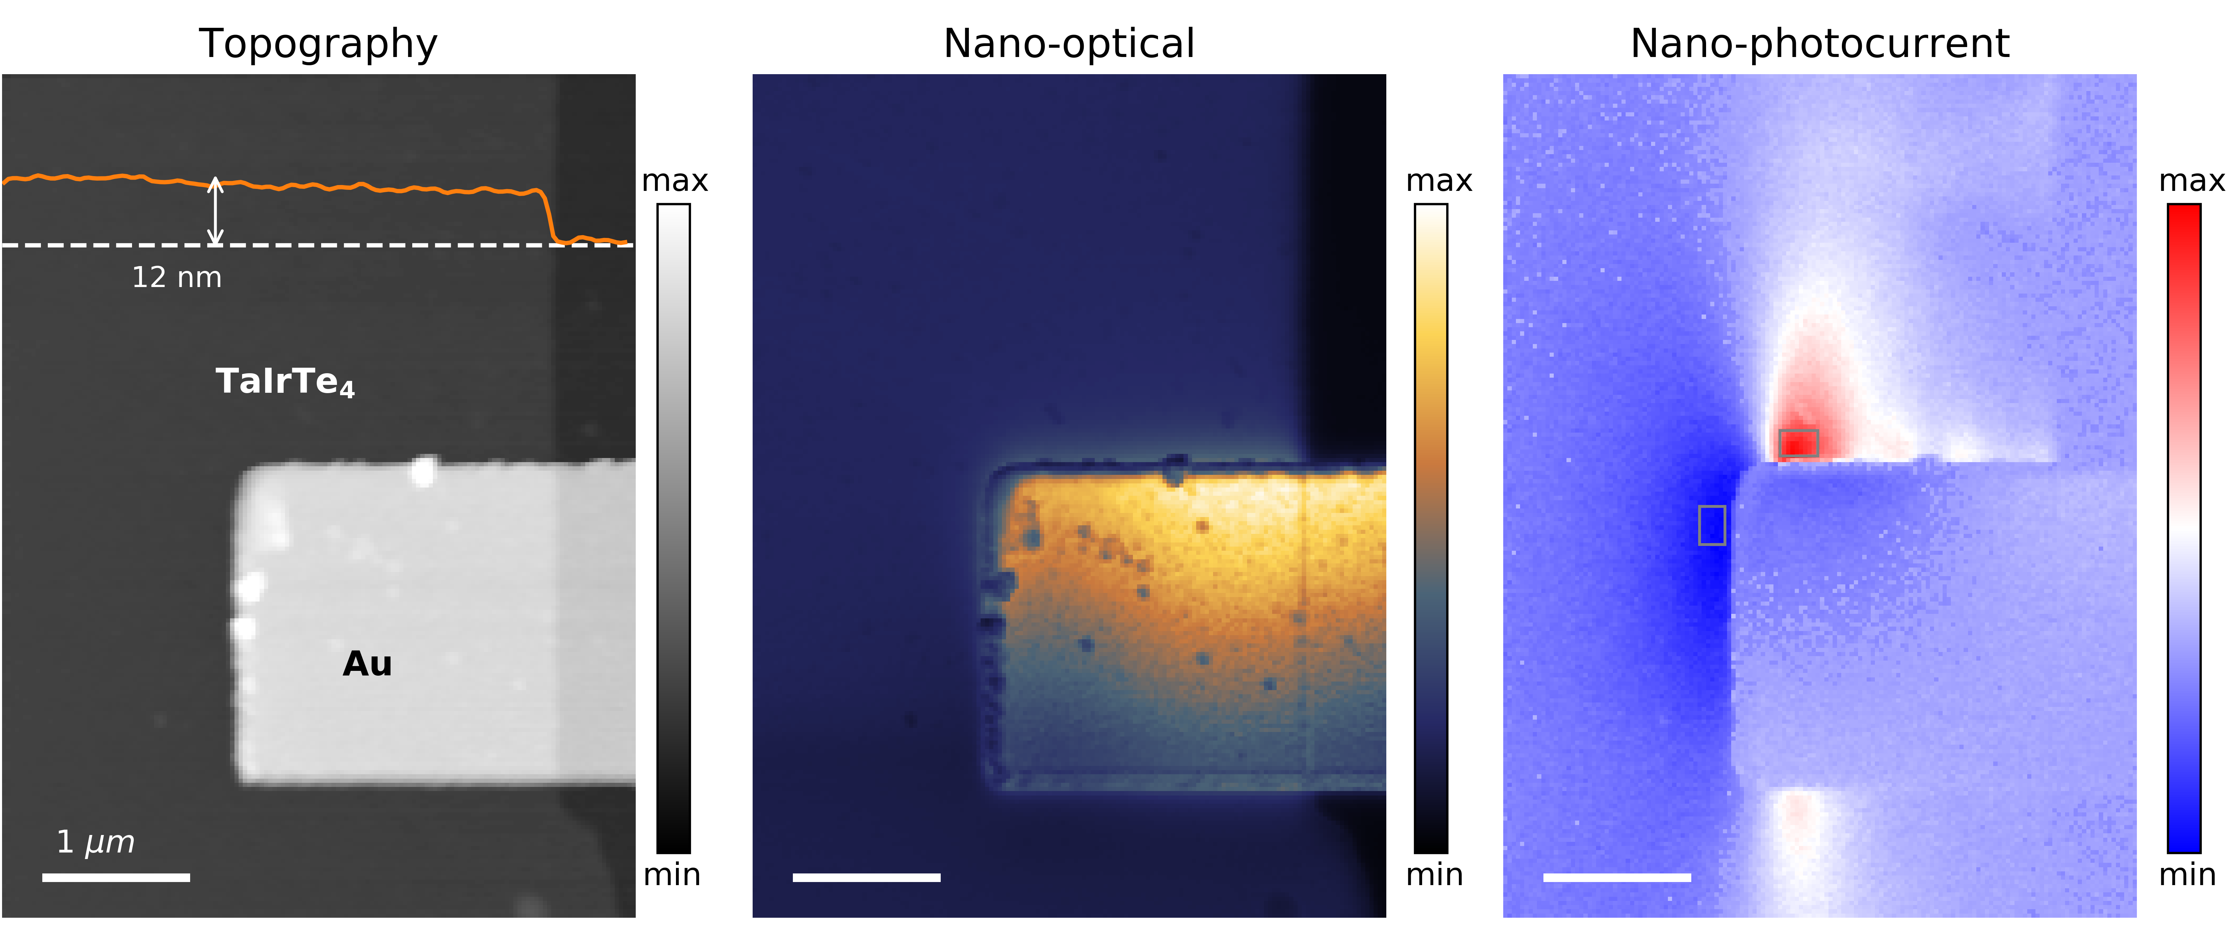
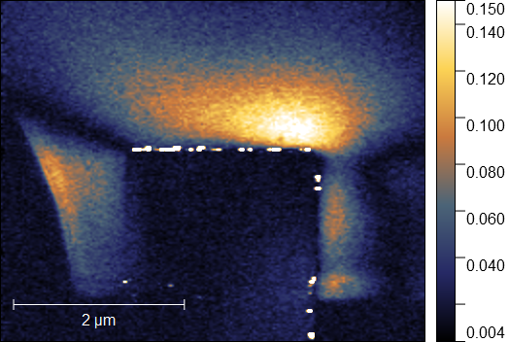
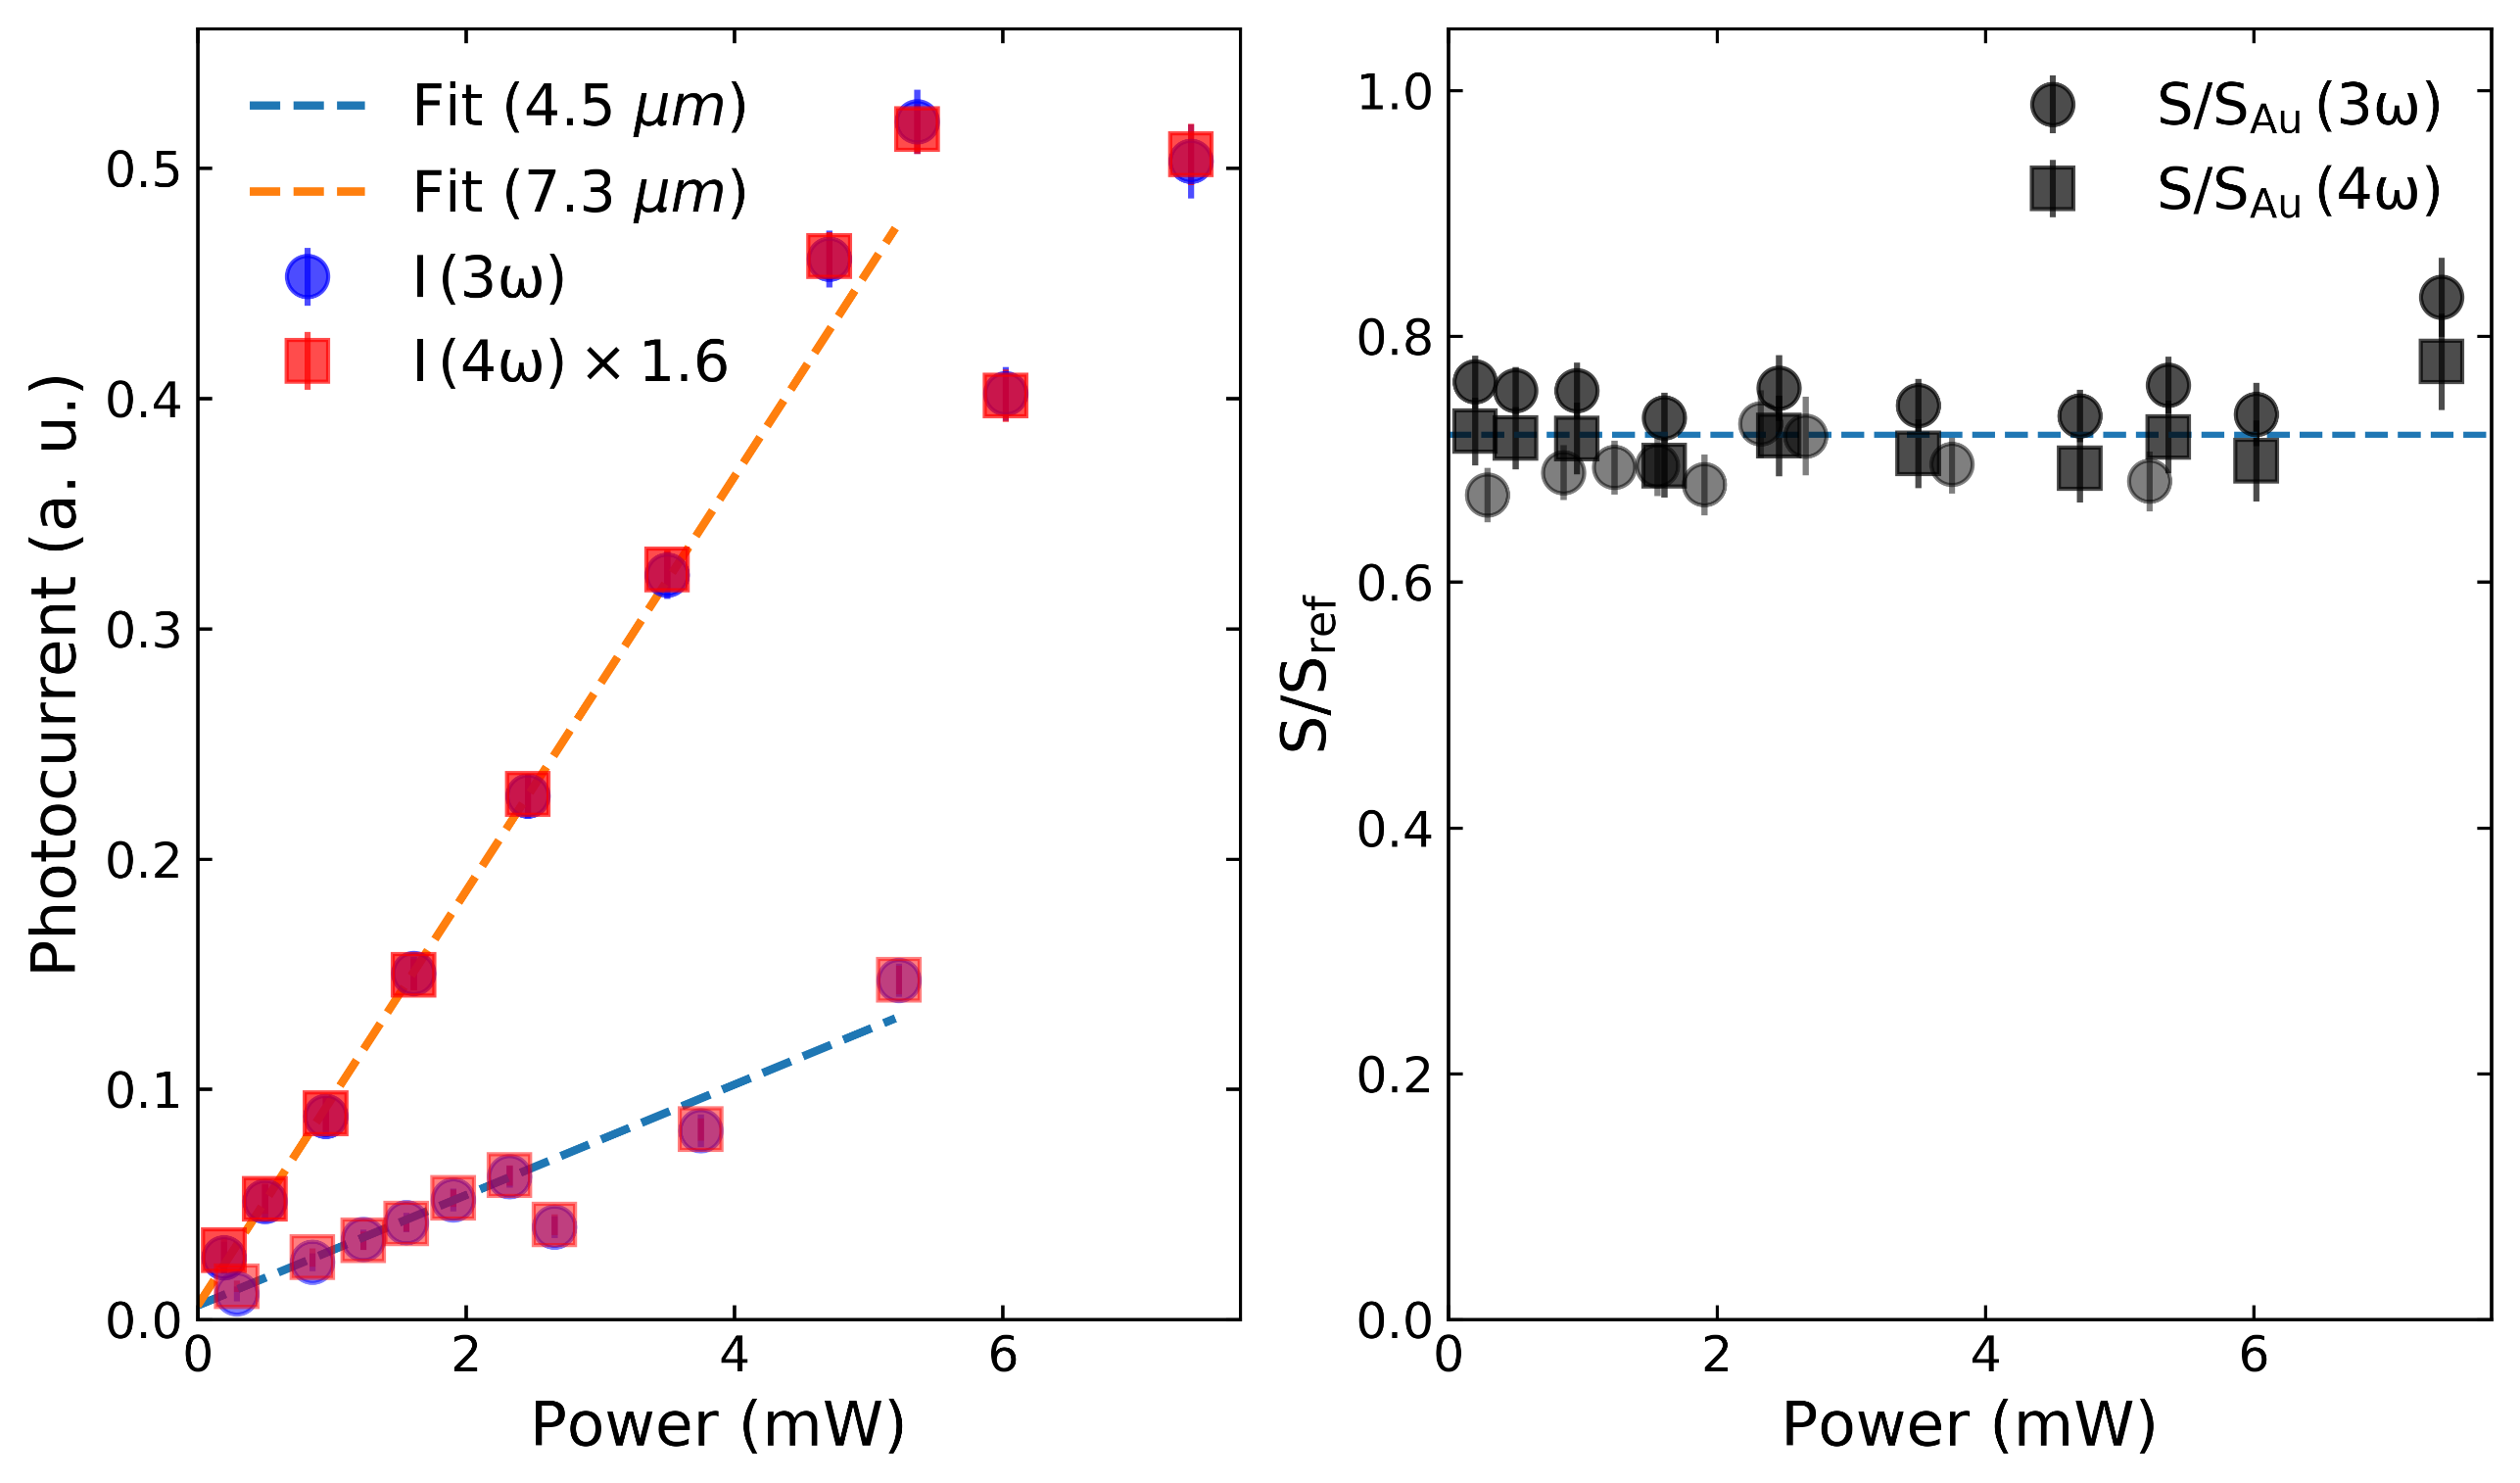
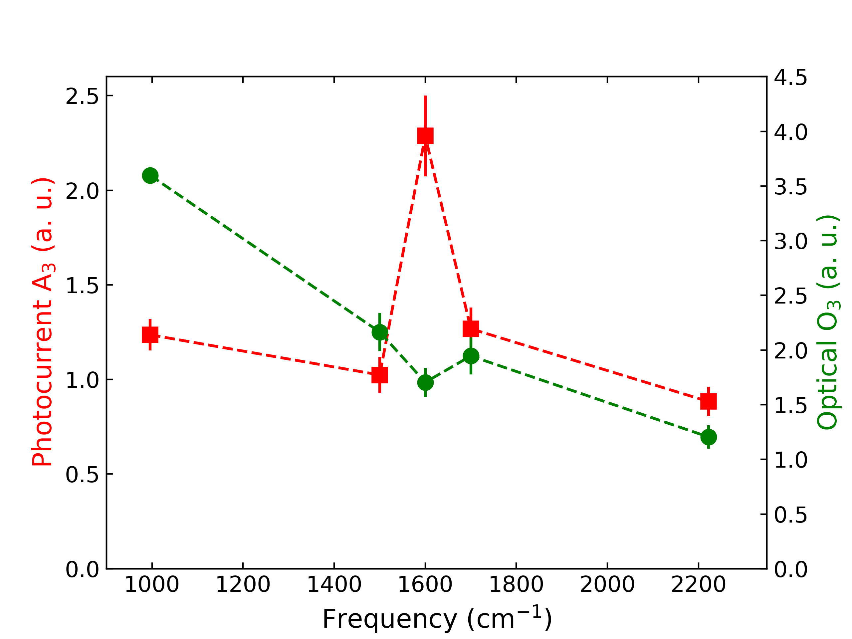
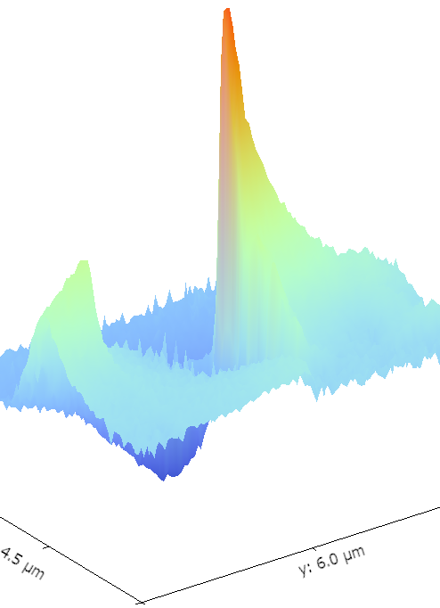
Nano-infrared Studies of Topological Semimetals
Yinming Shao, Columbia University, Collaborators: Sanghoon Chae (Columbia),
Eve Emmanouilidou (UCLA), Ni Ni (UCLA), James Hone (Columbia), Dimitri Basov (Columbia)
Energy Frontier Research Center funded by the U.S. Department of Energy, Office of Science, Basic Energy Sciences (BES), under award DE-SC0019443
Objectives:
Investigate Berry-curvature related effects in photocurrent response of topological semimetals
Compare nano-infrared/nano-photocurrent
Published and submitted results:
Yinming Shao et al (Nature Physic (in press))
Yinming Shao et al (in preparation)
Background:
TaIrTe₄ is an inversion-symmetry-breaking type-II Weyl semimetal [1] that has recently been shown to exhibit giant photocurrent response in mid-infrared wavelength range [2].
Crystal structure (left panel) and the corresponding Weyl points in momentum space (right), from Ref. [1].
Optical (left) and photocurrent (right) image of TaIrTe4, scale bar 20 um, from Ref. [2]
Results 1:
Sample: TaIrTe₄
Previous diffraction-limited photocurrent imaging study [2] has established very strong current response around 4.5 um and it has been claimed to result from Berry curvature enhancement. We use state-of-the-art nano-optical/photocurrent imaging techniques to further investigate the Berry curvature related effects.
[1] I. Belopolski et al, Nat. Commun. 8, 942 (2017)
[2] J. Ma et al, Nat. Mater. 18, 476 (2019)
Comparison of Nano-infrared and
Nano-photocurrent at $λ=$4.5 um
for thick TaIrTe₄ flakes
Reference: Au contact
Near-field (O3)
Optical image of a ~100 nm TaIrTe₄
thin flake on SiO₂/Si substrate
Results 3: “hot-spots” for thin flakes (~ 12 nm)
Photocurrent (A3)
By shining light on a metallic AFM tip,
we get localized optical response
function/photocurrent with ~30 nm spatial resolution at infrared wave-length (1~100 um).
Results 2:
Power and frequency dependence
Power dependence at 4.5 um/7.3 um on thick flake
Frequency dependence
Nano-photocurrent at 1600 ${cm}^{−1}$ for a ~12 nm thin flake shows very localized (< 300 nm)
“hot-spots” for strong photocurrent, not evident in previous studies on thicker flakes.
Moreover, the photocurrent signal exhibits interesting “sign-changing” behavior multiple
times near the Au contacts. The sign reversal is present and more complicated in thick
flakes. Theoretical understanding for this behavior is currently lacking.
Summary and future plans :
1. More frequency dependent nano-photocurrent for
TaIrTe₄ and related topological semimetals.
2. Perform low-temperature nano-photocurrent studies
to better understand the origin of the ‘sign-changing’
behavior of the nano-photocurrent map
3. Explore nano-photocurrent response in monolayers
of topological semimetals.
The near-field photocurrent shows linear power law behavior at low power, consistent with 2nd order response. At higher power the power dependence deviates from linear, while the (Au normalized) near-field optical signal remains flat with different incident laser power.
An increase of photocurrent as the light frequency approaches 1600 ${cm}^{−1}$ while the (un-normalized) near-field optical signal follows a gradual increase as frequency lowers.

