Slide 1
Economics in Tech
Megan Thomas, Amazon

Slide 2
Introduction
Megan D. Thomas
  University of Texas at Austin 2016 Ph.D.
  Background in Development Economics
  Senior Economist at Amazon
    Marketing
    Alexa
    Finance
    Optimization

Slide 3
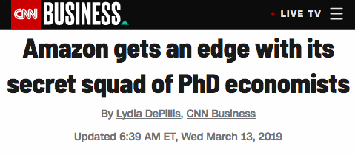
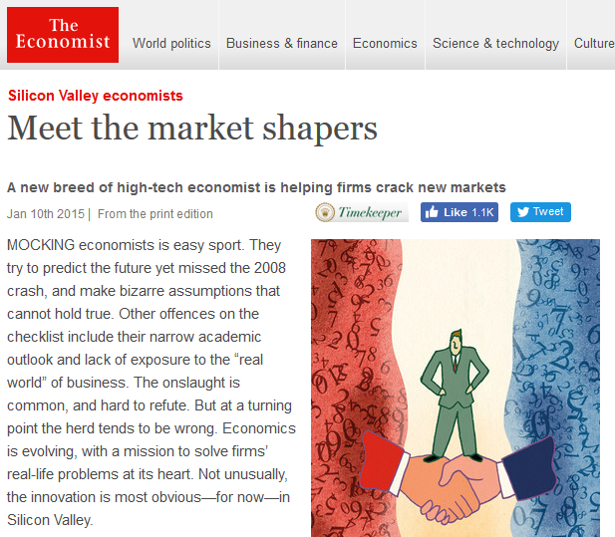
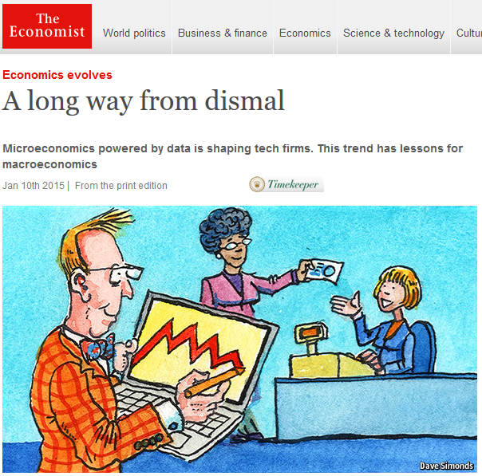
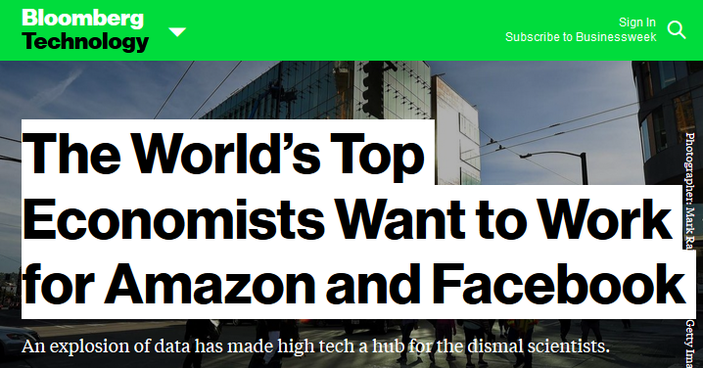

Slide 4
Economist Skill Set (Athey and Luca, 2019)
The ability to assess and interpret empirical relationships and work with data.
The ability to understand and design markets and incentives, taking into account the information environment and strategic interactions.
The ability to understand industry structure and equilibrium behavior by firms.

Slide 5
A Typical Day in the Life of an Economist
Meet the business team
  What ambiguous problem are they trying to solve?
  Work through the ambiguity and frame the question
Determine the Data and Modeling Approach
  Pull and process the right data from large databases
  Explore applicable econ models and/or ML techniques
Make a Product
  Work with Engineers to take the model and build a product
Have a Business Impact
  Guide the business on the right use the results and make them self sufficient to use the information from the product

Slide 6
Problems for Economists in Tech
  Demand Estimation
    New Products
  Forecasting
    Supply planning and optimization
    Planning labor needs at different times
    Improving P&Ls in Finance
  Causal Inference
    Effect of program changes
    Effect of customer driven actions

Slide 7
Techniques used by Economists in Tech
  Structural Modeling
  Forecasting
  Experimentation
  Quasi-experimental analysis
  Optimization
  Machine Learning

Slide 8
Some Examples from Experience
Marketing
  What is the effectiveness of our advertising channels?
  How do we effectively allocate spend across different channels?
  Which is the right channel for which audience?
  What is the optimal messaging and targeting?
Product : Alexa
  What is the long term impact of feature discover?
  What is the long term impact of a negative experience?
  Content optimization
  What features do we roll out next?

Slide 9
Some Examples from Experience
Finance
  Forecasting P&L items.
  Understanding macro effects on the company’s P&L.
  Understanding growth attribution to internal and external factors.
Featuring Sellers
  What is the best offer to show a customer for a given product?
  What is the effect on customers?
  What is the effect on sellers?

Slide 10
Career Growth
Independence in owning a product
Building a science team
Working with rich data
Working with people from diverse backgrounds
Having influence across different science projects
Seeing your work’s impact being realized in the real world

Slide 11
To learn more:
Athey, Susan, and Michael Luca. 2019. "Economists (and Economics) in Tech Companies." Journal of Economic Perspectives, 33 (1): 209-30

