Slide 1
Introduction to CPS _______ Wellness And Stress Management Anne Goldfield, Ph.D. Associate Director for Outreach and Community Response, Counseling and Psychological Services https://health.columbia.edu/content/counseling-and-psychological-services

Slide 2
Overview of CPS
CPS is an on-campus place to get support and talk with a mental health professional.
CPS offices are located in Lerner Hall on the 5th and 8th floors
During the academic year CPS is open:
Monday through Thursday - 8 AM to 7 PM
Friday - 8 AM to 5 PM
The staff is diverse and international
14 languages spoken
We see over 50% of undergraduates (GS, CC, SEAS) during their time on campus
Students can request specific providers and can ask to change providers if not a good fit
CPS clinicians adhere to strict standards of confidentiality.
Notes:
Problemn solving drop-in
Provides an opportunity to talk about a specific situation causing emotional distress
A single conversation may help the student gain clarity and manage ordinary life stressors
Briefer interventions help promote resilience and encourage students to rely on their inner resources
May be an opportunity to direct students to appropriate other campus resources
Among the issues typically discussed in these sessions are relationship problems, adjustment to campus life, roommate problems, career concerns, acculturation, or anxiety about academics
Urgent mental health concerns drop-in
Lerner 5
During the academic year
Monday through Thursday 6 to 9 PM
Student check-in closes at 8:30 PM
Sessions are brief and for the purpose of stabilizing the student and making a plan
Students may be referred for further treatment or directed to other resources.

Slide 3
CPS Services
CPS clinicians adhere to strict standards of confidentiality.
Student-life support spaces and workshops
CPS provides emergency consultation for faculty and staff who are concerned about a student
Brief individual counseling, Referrals for longer-term therapy, Psychiatric medication,
Drop-in and Emergency consultation
Access
Call 24 hours with questions and concerns
212-854-2878

Slide 4
Accessing Services at CPS: All Columbia students who have paid the full Columbia Health and Related Services Fee can access services. (This fee can be paid at any time during the year – it is NOT the same as the health insurance.)

Slide 5
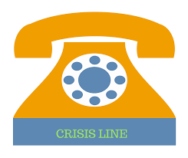
212 854-2878
CPS Appointments
and 24-hour
Support
Notes:
CPS clinicians see more than 50% of students from Columbia’s three undergraduate schools (CC, SEAS, GS), and over 20% of all Columbia students, during their years on campus
More than 6,000 students come to CPS annually. 97% report that they are satisfied with their care.
Our diverse and international staff includes clinical psychologists, psychiatrists, and social workers who collectively speak over 12 different languages.

Slide 6
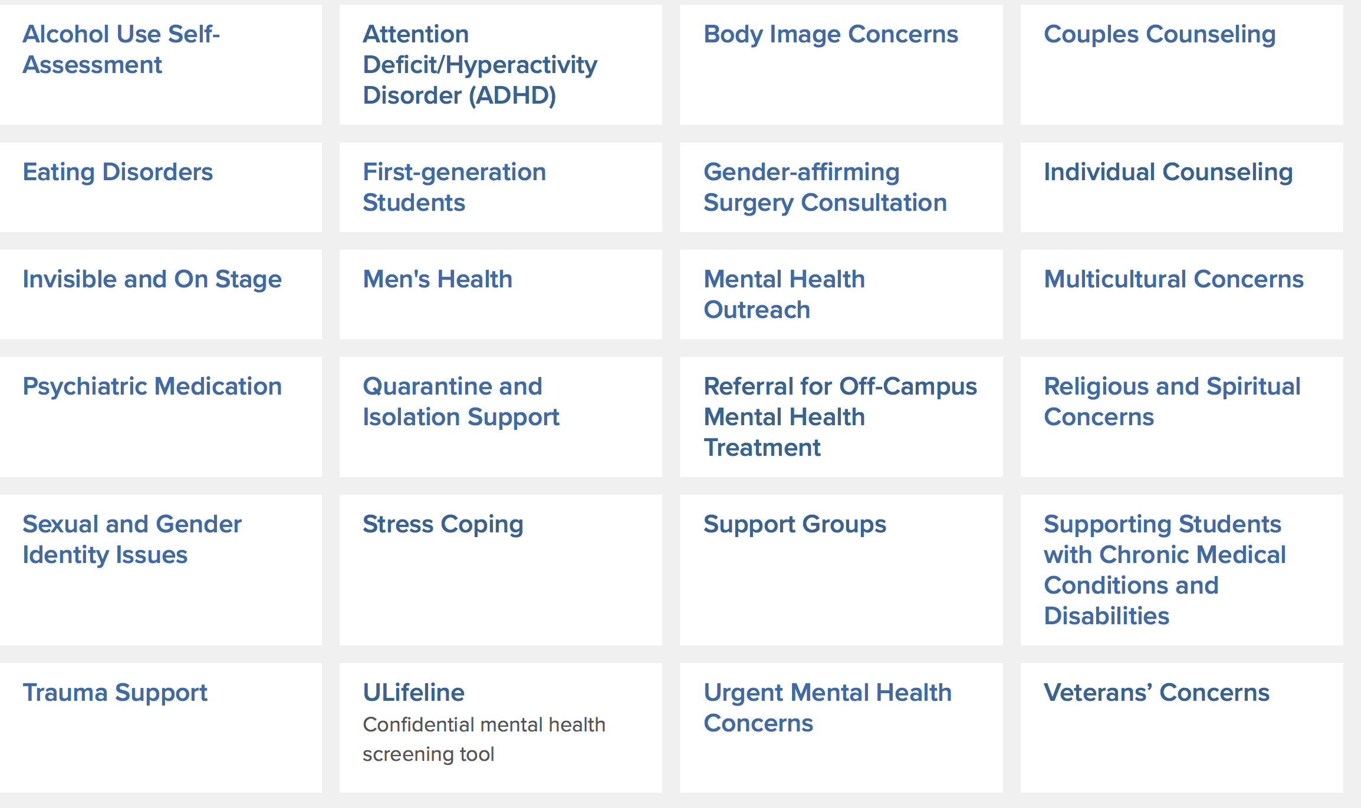
CPS Offers Support for the Following:

Slide 7
Ways To Connect With CPS
Schedule a Treatment Planning Session
Scheduled via phone or online
Student meets with psychologist for brief session
Typically, 20 mins via phone or Zoom
Intake at CPS (or referral for off-campus resources, if requested)
Intakes are always in-person

Slide 8
Additionally…
Problem Solving Drop-in
Urgent Mental Health Concerns Drop-in
Evaluation and brief intervention with CPS staff.
CPS Support Spaces
27 virtual groups offered this semester.
Across campus in academic buildings
Notes:
Some students are brought to CPS by a concerned administrator or faculty member. These students will be seen immediately.
Students also come to CPS through Drop-in meetings.
Problemn solving drop-in
Provides an opportunity to talk about a specific situation causing emotional distress
A single conversation may help the student gain clarity and manage ordinary life stressors
Briefer interventions help promote resilience and encourage students to rely on their inner resources
May be an opportunity to direct students to appropriate other campus resources
Among the issues typically discussed in these sessions are relationship problems, adjustment to campus life, roommate problems, career concerns, acculturation, or anxiety about academics
Urgent mental health concerns drop-in
Lerner 5
During the academic year
Monday through Thursday 6 to 9 PM
Student check-in closes at 8:30 PM
Sessions are brief and for the purpose of stabilizing the student and making a plan
Students may be referred for further treatment or directed to other resources.

Slide 9
CPS Virtual Support Groups https://health.columbia.edu/content/support-group Anxiety Management Virtual Support Space for Black Students Bereavement: You’re Not Alone Compassion for the Soul: A skills-based support space for women of color Coping Skills for Safety and Connection Coping with Trauma Cultivating Creativity and Resilience Dissertation Support Group Exploration of Asian Racial/Ethnic Identity A Support Group for International Students First Generation Virtual Support Group Healing from Sexual Trauma: Promoting Safety and Self-Care International Students Workshop The Koru Basic Mindfulness and Meditation course, Making Peace with Food Procrastination Workshop QT Talks: A Virtual Support Space for Queer & Trans Students Sleep SOS Skill Building Workshop for Couples Veterans in Transition Women Veterans Workshop

Slide 10
Concerns that bring students to CPS
Being in a state of emotional distress
Having difficulty coping with life or school
Experiencing:
Treatment Helps
Anxiety
Depression
Social isolation
Sleep disturbance
Frequent crying
Relationship difficulties
Body image issues
Substance use
Time management problems
Suicidal thoughts

Slide 11
Mental Health Treatment Helps
Talking with a mental health professional can decrease stress and emotional distress, can strengthen coping skills, and can help to foster resilience.
Most mental health problems respond well to psychotherapy - sometimes with medication as well - to allow the individual to enjoy a better quality of social life, work life and academic life.

Slide 12
Understanding and Managing Stress

Slide 13
What is stress?
When you’re stressed, the brain responds by prompting the release of cortisol, nature’s built-in alarm system.
This fight or flight system evolved to help animals facing physical threats by increasing respiration, raising the heart rate and redirecting blood flow from digestive organs to the muscles that assist in confronting or escaping danger.

Slide 14
We know that a moderate amount of stress can be motivating. But too much stress leads to both physical and emotional distress. We need to manage the stress response so that studying and writing papers don’t invoke an intense fight or flight level of stress.

Slide 15
What causes you stress? Short-term? Ongoing?

Slide 16
What helps you deal with stress?

Slide 17
There isn't a one-size-fits-all option when it comes to stress relief.
What works for one person might not work for another.
It's important to have a variety of stress relief tools at your disposal.
Then, you'll be able to pick a strategy that works best for your current circumstances.

Slide 18
Short-Term Stress-Relief Strategies
Can be performed anywhere
Take very little practice to master
Are free
Provide immediate relief

Slide 19
Guided Imagery
Guided imagery is like taking a short vacation in your mind.
Simply close your eyes for a minute and walk yourself through a peaceful scene.
Think about all the sensory experiences you'd engage in and allow yourself to feel as though you're really there.
After a few minutes, open your eyes and return to the present moment.

Slide 20
Focus on Breathing
Just focusing on your breath or changing the way you breathe can make a big difference to your overall stress level.
Deep breathing techniques can calm your body and your brain in just a few minutes.

Slide 21
Take a Walk
Exercise is a fantastic stress reliever that can work in minutes.
Taking a walk allows you to enjoy a change of scenery, which can get you into a different frame of mind and brings the benefits of exercise as well.

Slide 22
Develop a Positive Self-Talk Habit
The way you talk to yourself matters.
Harsh self-criticism, self-doubt, and catastrophic predictions aren't helpful.
If you're constantly thinking things like, "I can’t do it," and "I’m not good enough," you’ll increase your stress.
Talk to yourself the way you would talk to your best friend.

Slide 23
Try the S.T.O.P. stress management technique S –Stop what you are doing: Press the pause button on your thoughts and actions. T – Take a breath. O – Observe what is going on with your body, your emotions, your mind (what assumptions are you making about yourself and your feelings?) P – Proceed with whatever you were doing, making a conscious, intentional choice to incorporate what you just learned.

Slide 24
Additional ways to think about stress management – Part 1*
Action Orientated Approaches: used to take action to change a stressful situation
Emotion-oriented approaches: used to change the way we perceive a stressful situation
Acceptance-oriented approaches: used for dealing with stressful situations you can’t control
*Much of this section is adapted from PositivePsycholgy.com 7/15/21

Slide 25
Action-oriented approaches allow you to take action and change the stressful situation.
1. Be assertive
Clear and effective communication is the key to being assertive. When we’re assertive, we can ask for what we want or need, and also explain what is bothering us. The key is doing this in a fair and firm manner while still having empathy for others. Once you identify what you need to communicate, you can stand up for yourself and be proactive in altering the stressful situation.
2. Reduce the noise
Switching off all the technology, screen time, and constant stimuli can help us slow down. How often do you go offline? It is worth changing, for your own sake.
Make time for some quietness each day. You may notice how all those seemingly urgent things we need to do become less important and crisis-like. That to-do list will be there when you’re in a place to return to it. Remember that recharging is a very effective way of tackling stress.
3. Manage your time
If we let them, our days will consume us. Before we know it, the months have become overwhelmingly busy. When we prioritize and organize our tasks, we create a less stressful and more enjoyable life.

Slide 26
4.Creating boundaries
Boundaries are the internal set of rules that we establish for ourselves. They outline what behaviors we will and won’t accept, how much time and space we need from others, and what priorities we have.
Healthy boundaries are essential for a stress-free life. When we have healthy boundaries we respect ourselves and take care of our well-being by clearly expressing our boundaries to others.
5. Get out of your head
Sometimes it’s best not to even try contending with the racing thoughts. Sometimes you just need a break. Distract yourself. Watch a movie, phone or catch up with a friend, go for a walk, or do something positive that you know takes your mind off things.

Slide 27
Emotion-oriented approaches are used to change the way we perceive stressful situations.
6. Affirmations and imagery
The power of positive imagery and affirmations is now scientifically proven to increase positive emotion.
How? When you think of a positive experience, your brain perceives it to be a reality.
So, replace those negative thoughts with positive statements and challenge and change the way you see and experience the world.
7. Cognitive Restructuring
This is a technique for understanding negative emotions and challenging the sometimes-incorrect beliefs that cause them. Cognitive restructuring is a key component of Cognitive behavioral therapy (CBT).
8. ABC Technique
The letters ABC stand for; A – adversity, or the stressful event. B – beliefs, or the way that you respond to the event. Then C – consequences, the result of your beliefs lead to the actions and outcome of that event.
For example, poor grade – I’m a lousy student – I’m miserable and less motivated.
Essentially, the more optimistic your beliefs, the more positive the outcome.

Slide 28
Acceptance-oriented approaches are useful in stressful situations that you cannot control.
9. Diet and Exercise
You’ve heard it before, but you are what you eat. Be mindful of having a balanced and healthy diet. Making simple diet changes, such as reducing your alcohol, caffeine and sugar intake is a proven way of reducing anxiety.
Another guaranteed way to reduce stress is exercise. It’s proven to also be as effective as antidepressants in relieving mild depression.
10. Meditation and physical relaxation
Use techniques such as deep breathing, guided visualizations, yoga, and guided body scans. These activities help relax the body. Some examples for you to try out are included below.

Slide 29
11. Build resilience
Resiliency is our ability to bounce back from stressful or negative experiences.
To simplify, resilient people are skilled at accepting that the situation has occurred, they learn from what transpired and then they move on.
12. Talk it out
Don’t hold it all inside. Talk to someone close to you about your worries or the things getting you down. Sharing worries can cut them in half, and also give you a chance to laugh at potentially absurd situations.
Many of our worries sound a lot less worrisome when we say them out loud.
If you don’t feel up to sharing, writing them down is also a great way to release them. Or maybe engage with an independent professional. There are plenty of services available, including free services, which you can quickly google to find what’s available in your city.
13. Sleep
Getting a good night sleep is fundamental for recharging and dealing with stressful situations in the best possible way. While it varies from individual to individual, on the exact amount of sleep needed, an uninterrupted sleep of approximately 8 hours is generally recommended.

Slide 30
Additional ways to think about stress management – Part 2 The Four A’s for Stress Management

Slide 31
1. Avoid Stress Say, NO. Know your limits and stick by them. Get up 15 minutes earlier so you don’t have to rush. Organize and prioritize your tasks for the day. Make to-do lists and break tasks down into manageable chunks! Try not to take on more responsibility than you can reasonably manage. Set clear time boundaries with friends and family.

Slide 32
2. Alter Stress We’re often not able to avoid a stressor in our life. One of the most helpful things you can do during times of stress is to take inventory, then attempt to change your situation for the better. Manage your time better. The reward of increased efficiency will be extra time. Don’t bottle up your feelings. Communicate your needs. Join or create a study group and get support. Surround yourself with friends and fellow students who support your well-being. Build an Anti-stress culture!

Slide 33
3. Adapt To Stress Can’t avoid or change the stressor? How about changing your own self? Adapting to stressful situations can actually help you have a sense of control over the situation. It is okay if things didn’t happen as perfectly as you wanted it to be. Don’t stress over it. Some days adjusting your standards can actually help you feel less stressed over a particular situation. Change your lens. Sometimes we perceive a situation as stressful whereas if we change our lens, in that case, we can actually shift our perspective about a stressful situation. If you can, it will help you feel less frustrated and happier in that situation.

Slide 34
4. Accept Stress There are times when the only response is to accept things as they are. Know things you can control and you can’t control and decide not to stress over things that fall in the latter category. Because things you don’t have control over should be not stressed about, rather they should be accepted as they come. Like- bad weather! If the stressful situation arises from an outside source think of it as an opportunity for personal growth and if it is a result of your own poor choices, then learn from it. Accept the limitations of others in your life. Learn to forgive.

Slide 35
Managing Impostor Syndrome :
(A secret fear that people will find out you’re not as smart as they think.)
Accept that these feelings are normal and that many other students also feel that way.
Understand the difference between observing a thought and embracing it. You may feel that way, but you don’t have to embrace that feeling/thought.
The only way to stop feeling like an impostor is to stop thinking like an impostor.
Work to improve, not to be perfect. Competence is not the same thing as perfection.
Get help when you need it.
Know that occasional mistakes are inevitable and okay, sometimes they are even good.
You will build confidence as you keep working and have successes.

Slide 36
To survive and thrive at Columbia: Set realistic goals for yourself. Create balance in your life. Watch out for impostor syndrome. Remember your successes and celebrate them.

Slide 37
Thank you! Questions or comments?

