Slide 1
5 Targets for Good Nutritional Choices
Healthy Hydration
Simple Preparation Tips … delivery is ok

Slide 2
5 Targets for Good Nutritional Choices … a compilation of recommendations from various health agencies
Have half your grains whole
5-a-Day the Color Way
Eat beans daily
Include omega-3 fats at least 3 times a week
Be fussy about fats – monounsaturated & omega 3:6 ratio

Slide 3
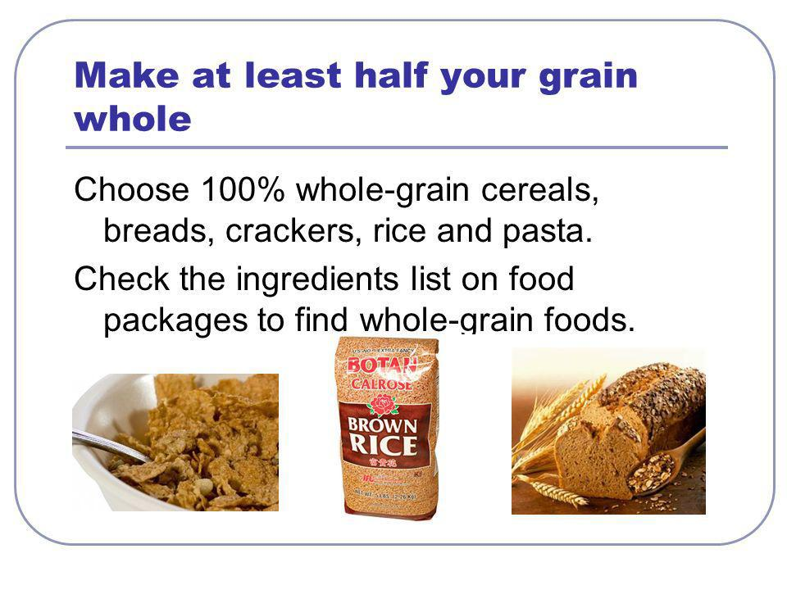
# 1
http://images.slideplayer.com/2/773023/slides/slide_4.jpg

Slide 4
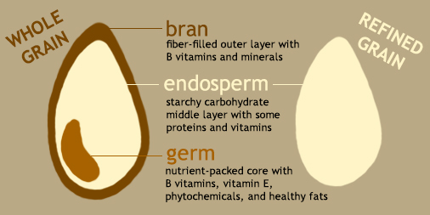
# 1

Slide 5
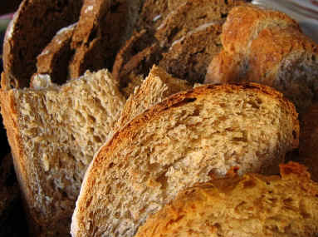
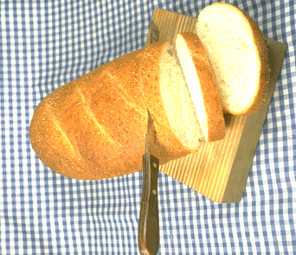
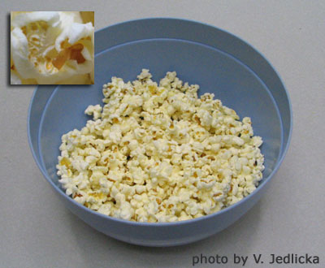
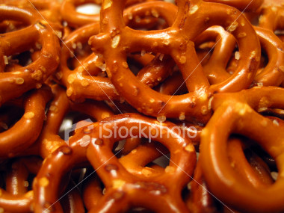
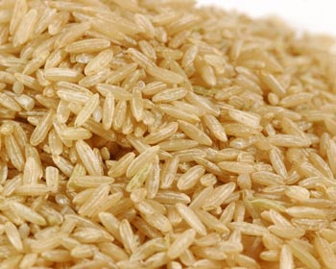
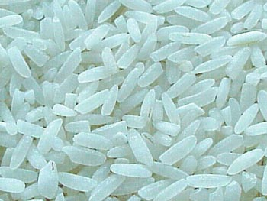
have half your grains whole
# 1
whole wheat
popcorn
brown rice
… instead of white
…instead of pretzels
… instead of white rice
whole wheat bread sticks, whole grain breakfast cereal,
unsalted nuts & seeds with dried fruit, whole wheat crackers make good desk drawer supplies

Slide 6
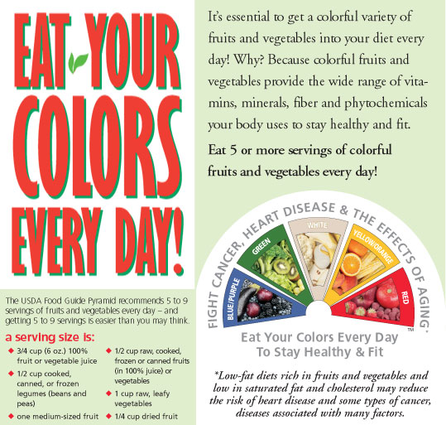
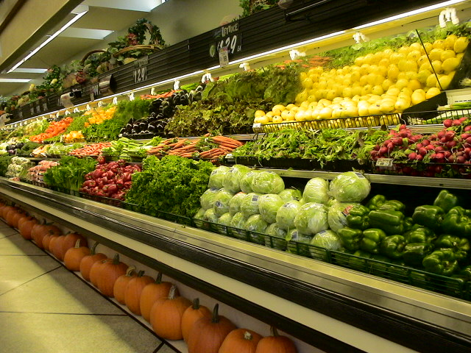
5-a-Day the Color Way
# 2

Slide 7
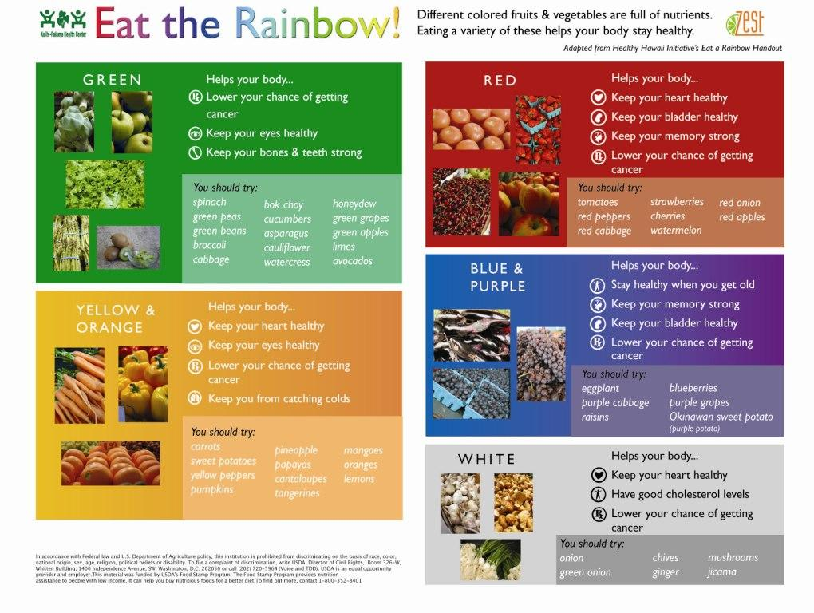
# 2

Slide 8
# 2

Slide 9
# 2

Slide 10
# 2

Slide 11
# 2

Slide 12
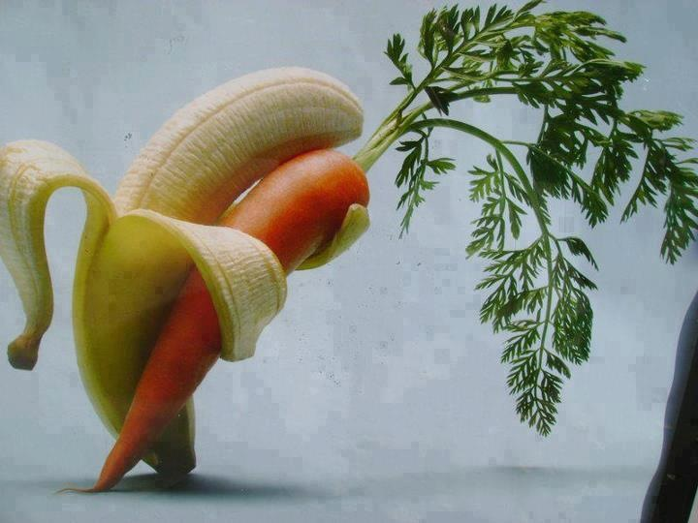
This campaign promotes:
# 2
FIBER – SOLUBLE & INSOLUBLE
ANTI-OXIDANTS
BETACAROTENE
INDOLES
VITAMIN C

Slide 13

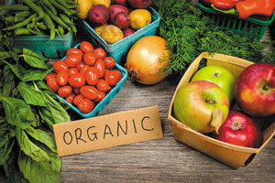
But, what you’re all thinking is …
… organic better?
Organic agriculture aims to preserve natural resources, support animal health and welfare, and avoid most synthetic materials … the USDA regulates the organic industry with strict standards. The soil where crops are grown must be inspected and shown to be free of most synthetic pesticides and fertilizers, and the crops cannot have been genetically modified. Animals raised on organic farms receive no antibiotics or growth hormones, are given feed that has been grown organically, and are able to roam around outside.
While organic foods have fewer synthetic pesticides & fertilizers and are free of hormones and antibiotics, they don't appear to have a nutritional advantage over their conventional counterparts…. been a number of studies examining the macro- and micronutrient content … the foods are really similar for vitamins, minerals, and carbohydrates …

Slide 14
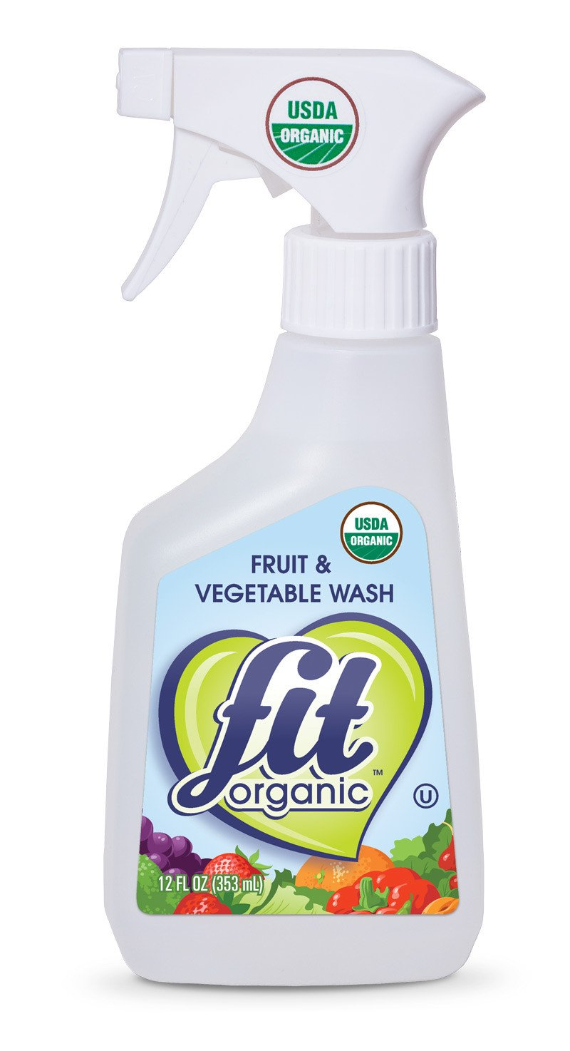
What about handling? Washing? Rinsing?
washing with water reduced dirt, germs, pesticide residues on surfaces
holding the fruit or vegetable under flowing water removes more than dunking the produce
peeling or scrubbing produce like potatoes with a stiff clean brush or rubbing soft items like peaches while holding them under running water works best to remove residues
using special vegetable washes may not be more effective than just water
no bleach
http://npic.orst.edu/capro/fruitwash.html#:~:text=No%20washing%20method%20is%20100,once%20they%20have%20been%20applied.

Slide 15
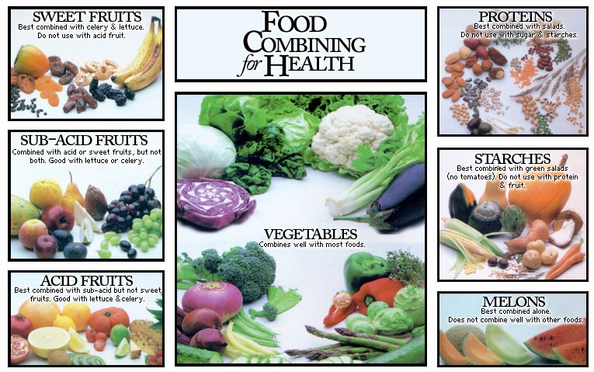
NOT VALID

Slide 16

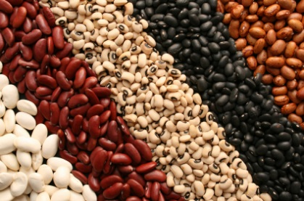
… eat beans daily …
https://beaninstitute.com/
# 3
… salads
… soups
… stews
… side dishes
... dips

Slide 17
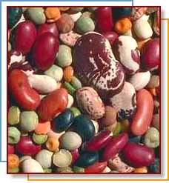
Everyone - have bountiful bowls of beans
# 3
Up to 10 or more grams of soluble fiber per day can reduce LDL by 5% more than what is achieved with a very low fat diet.
Insoluble fiber does not accomplish this effect.
The best sources are the gums found in: oat bran, beans, peas, & barley, and the pectin found in: citrus, berries, & apples.

Slide 18
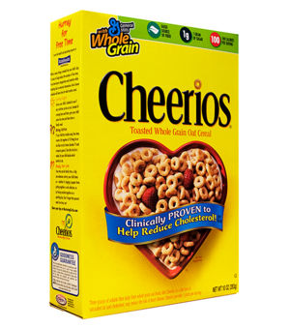
Total & Soluble Fiber in Foods – 5 – 10 grams recommended
Serving total fiber sol fiber
Green peas, ²/3 c 3.9 0.6
Kidney beans, ½ c 4.5 0.5
Lentils, ²/3 c 4.5 0.6
Lima beans, ½ c 1.4 0.2
Pinto beans, ½ c 3.0 2.2
White beans, ½ c 4.2 0.4
Serving total fiber sol fiber
Broccoli, 1 stalk 2.7 1.3
Carrot, 1 large 2.9 1.3
Corn, 2/3 c 1.6 0.2
Lettuce, 1 c 0.5 0.2
Parsnips, ½ c 4.4 0.4
Peas, ½ c 5.2 2.0
Tomato, small 0.8 0.1
Zucchini, ½ c 2.5 1.1
http://www.fatfreekitchen.com/soluble-fiber-foods-list.html

Slide 19
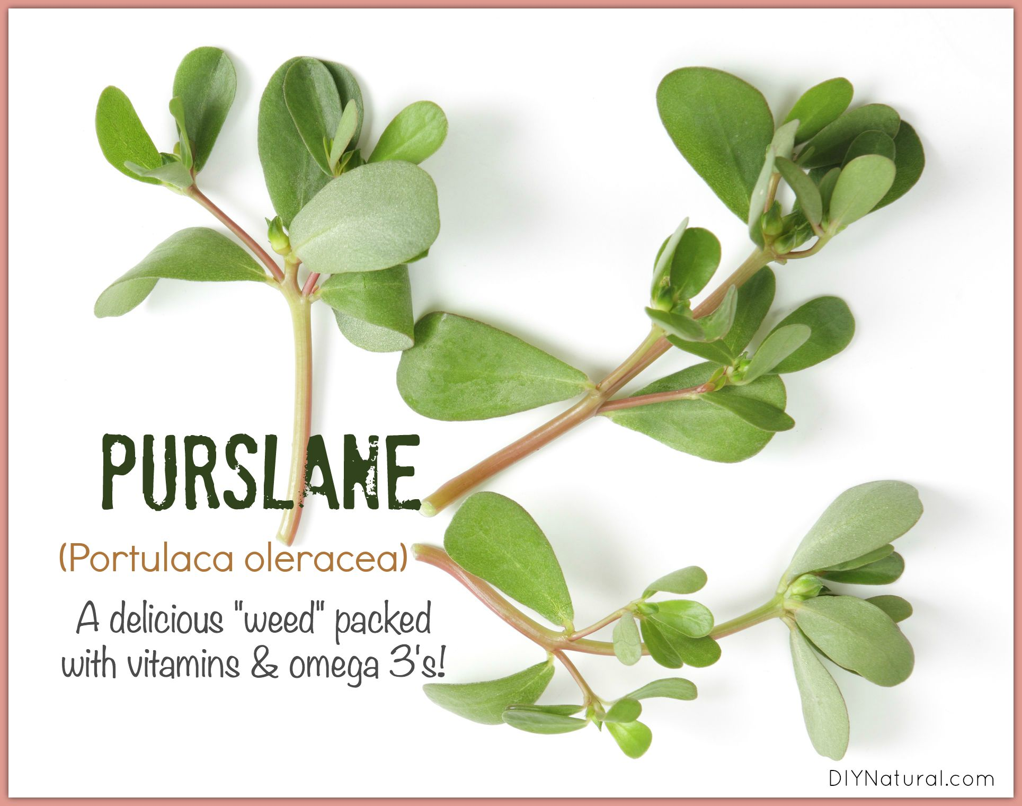
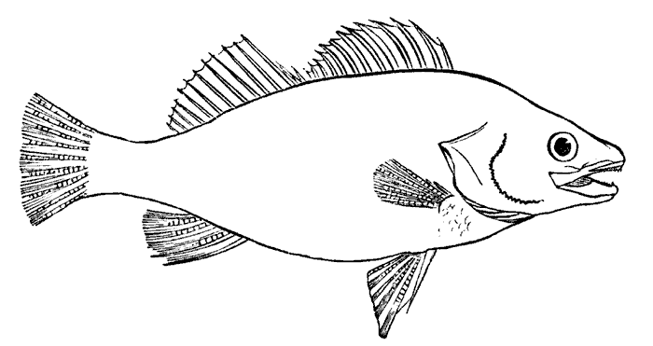
Have foods containing long-chain omega-3 fatty acids 2-3 times a week
# 4
…. Fish is “best” source …
ALA alpha-linolenic acid (C18:3)
EPA eicosapentaenoic acid (C20:5)
DHA docosahexaenoic acid (C22:6)
From: fish liver oils & poultry fed fish meal
http://www.pcrm.org/health/health-topics/essential-fatty-acids

Slide 20
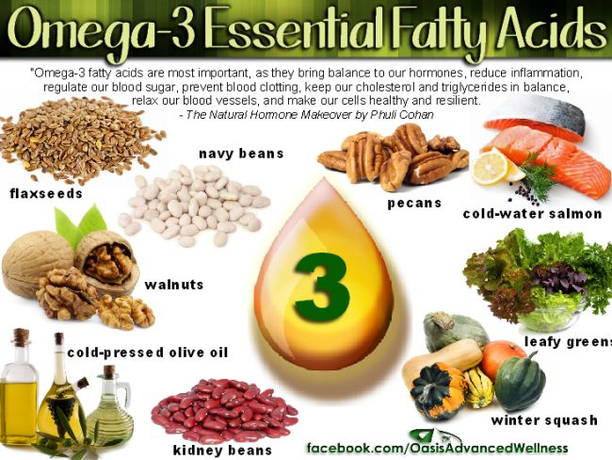

Slide 21
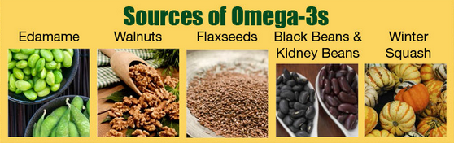
From plants … you can kind of forage for …
# 4
canola & soybean oils and purslane
https://ods.od.nih.gov/pubs/usdandb/ALA-Content.pdf

Slide 22
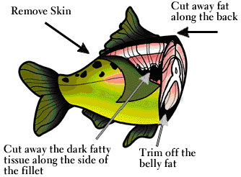
Fish
http://www.wcs.org/gofish
Excellent for omega-3 fatty acids
Excellent protein
Latest report says benefits out weight dangers …😐?

Slide 23
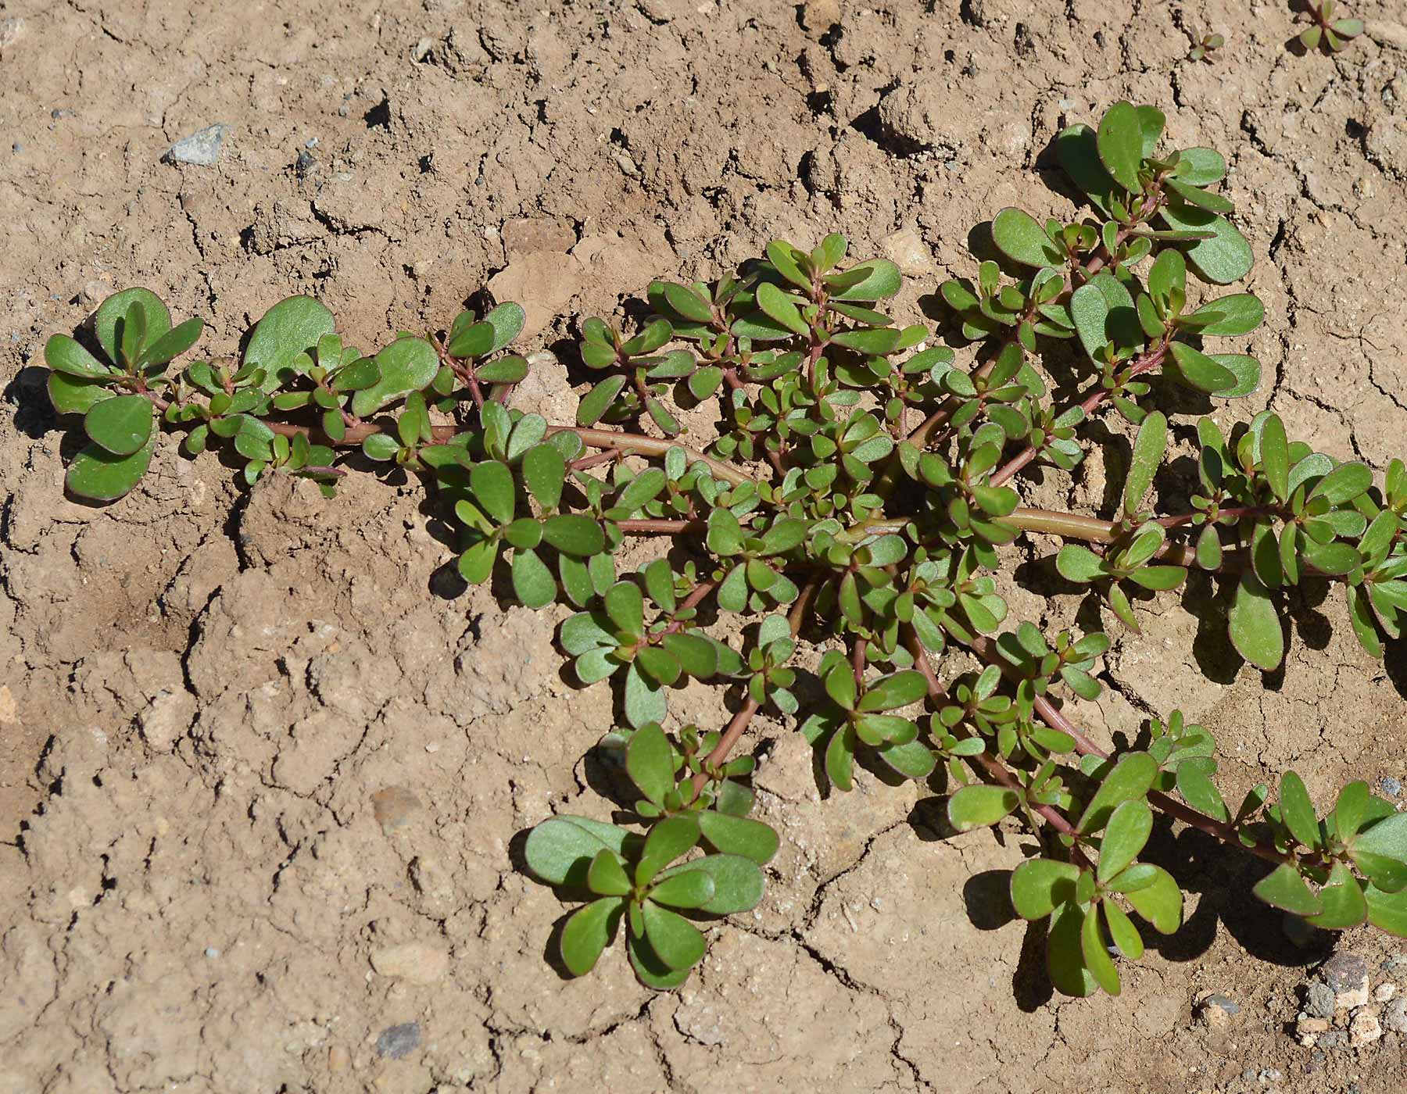
# 4
https://www.diynatural.com/purslane-portulaca-oleracea/

Slide 24
Omega-3 fats
# 4
250–500 mg combined EPA and DHA each day for healthy adults
salmon, chinook, cooked, dry heat - 3.0 oz = 0.8581 gram or 800 mg
tsp. fat ~ 4-5 grams
Life Stage | Recommended Amount of ALA
Birth to 12 months* | 0.5 g
Children 1–3 years | 0.7 g
Children 4–8 years | 0.9 g
Boys 9–13 years | 1.2 g
Girls 9–13 years | 1.0 g
Teen boys 14–18 years | 1.6 g
Teen girls 14–18 years | 1.1 g
Men | 1.6 g
Women | 1.1 g
Pregnant teens and women | 1.4 g
Breastfeeding teens and women | 1.3 g

Slide 25
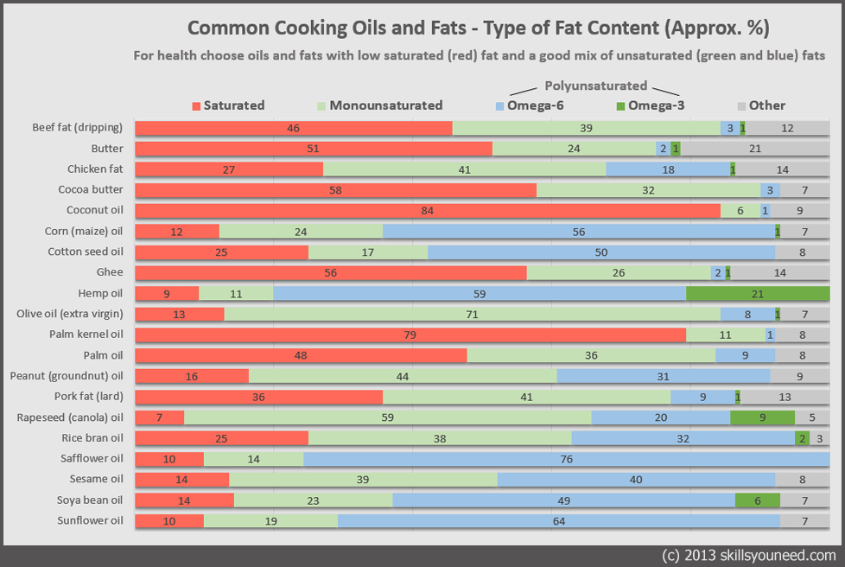

Slide 26
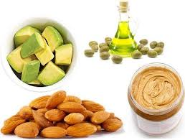
Enjoy MONOUNSATURATED fats such as olive oil, canola oil, avocado & nuts (cashews, almonds, peanuts)
# 5

Slide 27
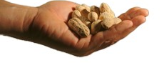
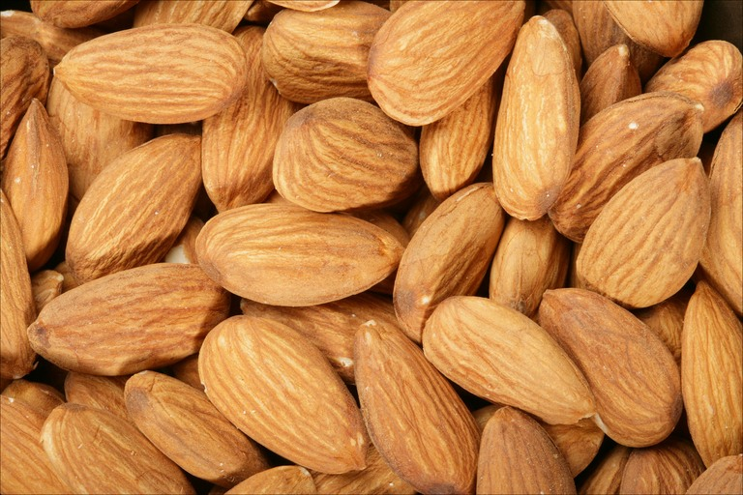
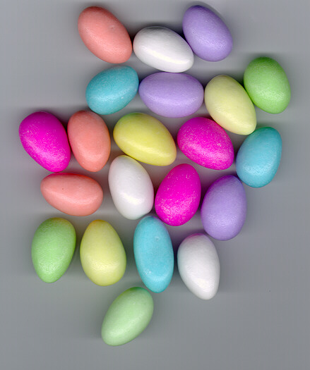
Everyone - Have a handful of nuts a day
Almonds:
University of Toronto found that people eating a handful of almonds a day as part of a healthy diet lifestyle lowered their LDL-cholesterol 3%.
bioactivity of the antioxidants in almond skin ⬆ the resistance of human LDL to oxidation. The flavonoids increased the lag time to LDL oxidation in a dose-dependent manner
Journal of Nutrition issue 135, pp1366-1373

Slide 28
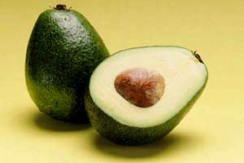
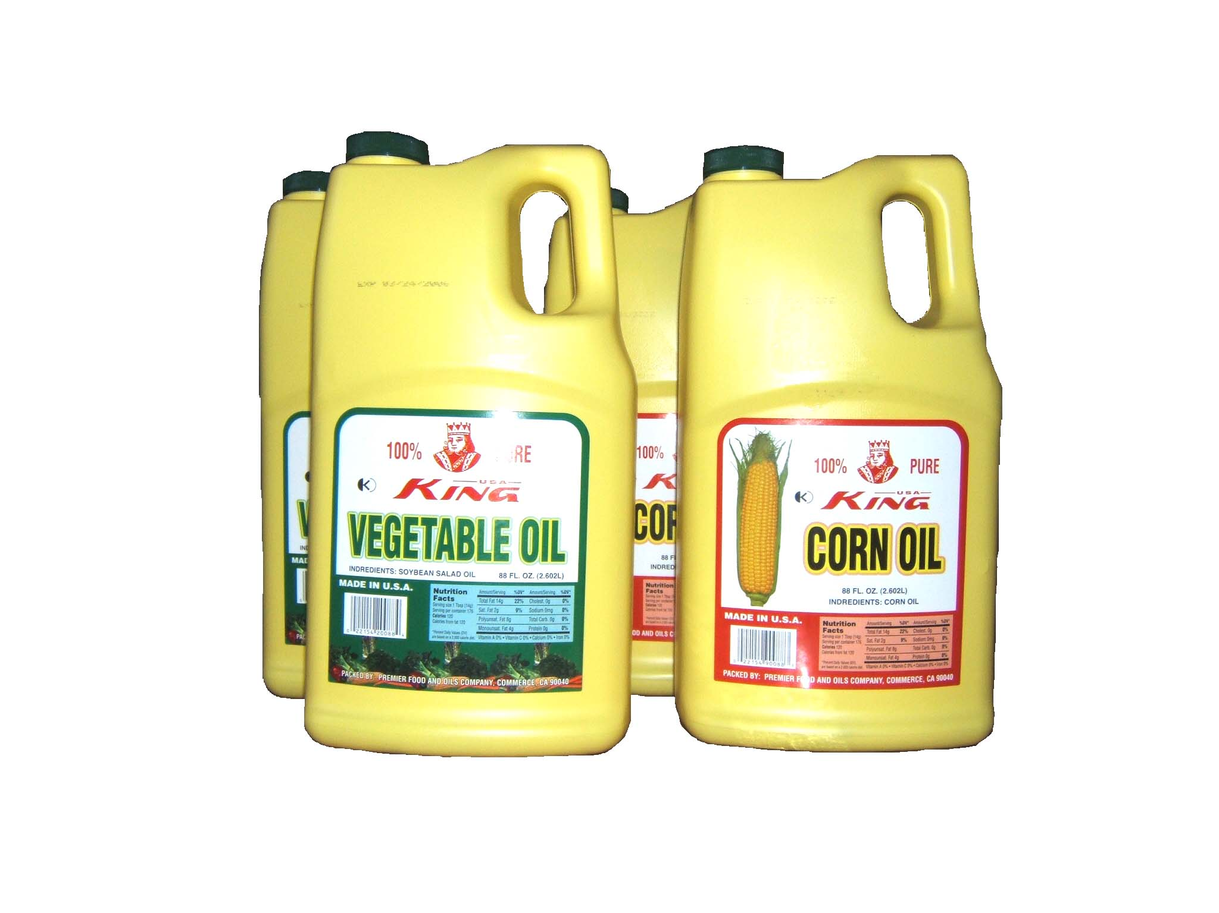
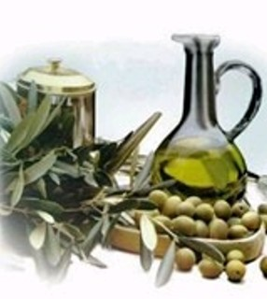
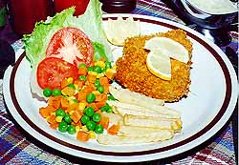
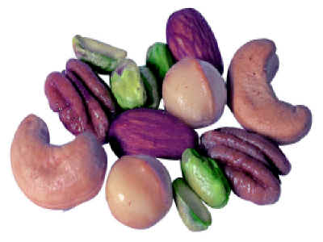
less Omega-6 PUF & more MUF
# 5
PUF MUF
LDL ⬇ ⬇
total cholesterol ⬇ ⬇
HDL ☹⬇ ~ or ⬆☺
triglycerides ~ ~
Immunity ☹⬇

Slide 30
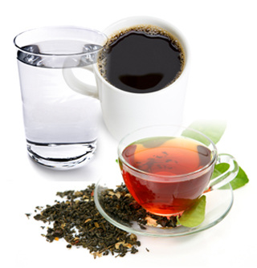

Healthy Hydration
enjoy a variety of fluids
fluid also comes from fruits, vegetables, diary and meats
For some people, these factors will affect hydration
medications
kidney function
less thirst
illness

Slide 31
Healthy Hydration
8 glasses of water a day … not really
No medical evidence of need or in weight loss
Clearly needed in physical training
More fluid consumed, more excreted, increase in urinary losses of calcium & iron
Body makes about 12 oz. of “metabolic” water a day
No objective criteria for removal of “toxins”
Thirst matches water needs except in infants, children, elderly, poor renal function, marathon runners

Slide 32
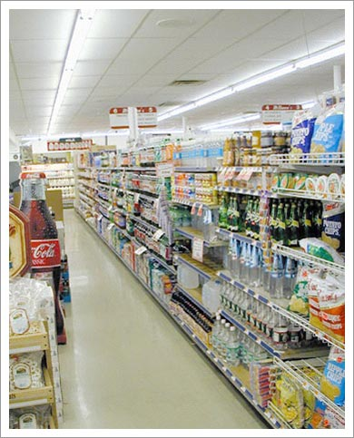
Beverages
water’s best
consider “silent” calories of soft drinks
soft drinks = fruit juice
caffeine sensitivity?
others are “gotchas”
boxed water https://earth911.com/business-policy/is-boxed-water-better/

Slide 33
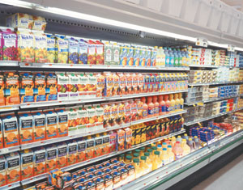
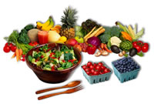
Fruit beverages
What are the advantages? – vitamin C, convenience
What are the disadvantages? – high sugar
Chew your fruit, don’t drink it

Slide 34
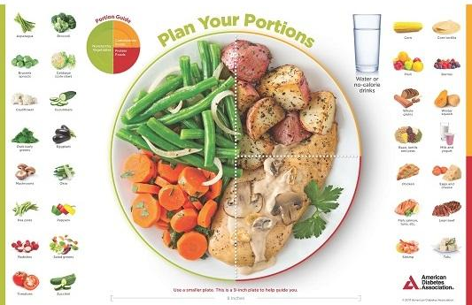

Slide 35
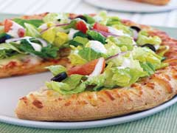
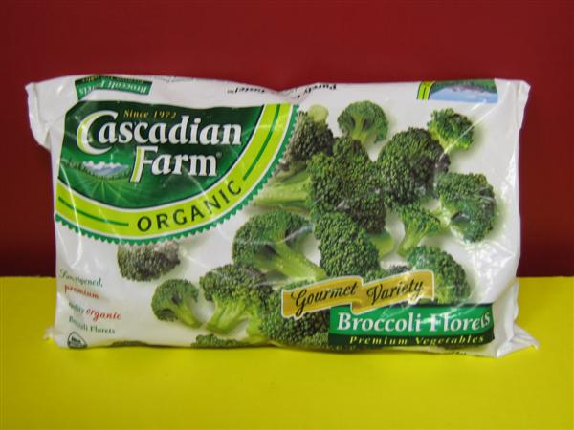
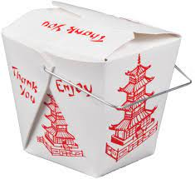
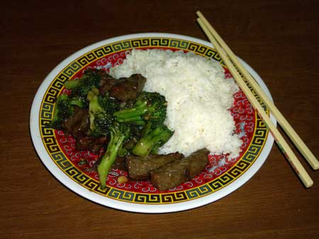
Take convenience food & make it better
Add more vegetables to pizza, add a side salad.
Add more vegetables to the stir fried beef & broccoli.
+
+
=

Slide 36


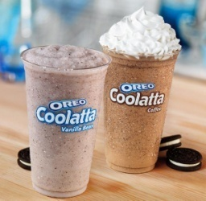
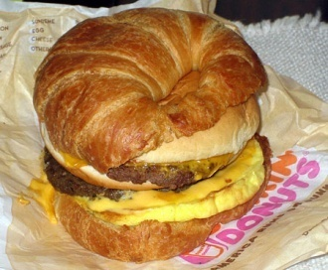

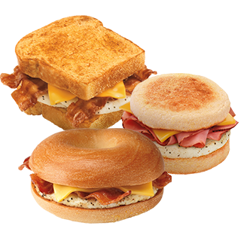
What if you drop it to?
Pretty Good 😐
Small …
Without cheese
Egg white & flat bread
Without “meat”
Pretty Pushy ☹ OMG
Syrupy flavors
large sizes
On croissants
With cheese
Muffins
doughnuts

Slide 37



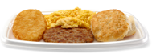



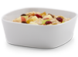

What if you drop it to?
Pretty Good 😐
  Egg McMuffin
  Eggwhite Delight
  1% fat milk
  Coffee
  Parfait
  oatmeal
Pretty Pushy ☹ OMG
Sausage McMuffin
Big Breakfast
Big Breakfast with Hot Cakes!!
“Hash Brown”
Cinnamon melts
http://www.mcdonalds.com/us/en/food/full_menu/breakfast.html

Slide 38
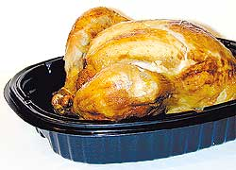
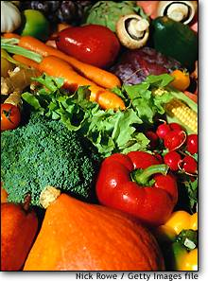

Protein food + veg-1 + veg-2 + starchy food = good meal cooked chicken + broccoli + mushrooms + rice = stir fry beef strips + peppers + onions + noodles = skillet dish stew beef + carrots + celery + (above) + potatoes = stew beans & cheese + lettuce + tomatoes + tortilla = fajita eggs & milk + chopped spinach + toast = Eggs Florentine gr meat + tomato sauce + salad + spaghetti = pasta & sauce frozen shrimp + okra + tomatoes + limas & corn = gumbo
+
=

Slide 39






Delicious gumbo!
❶ ❷ ❸ ❹ ❺
In a large pot, bring 1 inch … add a bag or box of 1 bag or box of frozen 1 bag or box of 1-2 cans diced
of water to a boil … frozen corn cut okra lima beans tomatoes

Slide 40

Easy Prep for Healthy Meals
1 bag frozen chicken breasts
1 box or 2-4 bags of rice
1 bag carrots
1 bag of string beans
2 potatoes
Bananas
1 small or medium cookie sheet.
Food storage containers
Foil
Mrs. Dash Salt-Free seasoning
1 bag mixed veggies
1 small or medium size pot to boil water
http://lusciouslivingtoday.com/easy
-food-prep/

Slide 41

It’s not easy to eat less
The stomach, intestines, pancreas, and fat cells all make hormones that that signal at least 3 regions of the brain that tell us to stop eating or continue eating
Food industry has found the “BLISS POINT” to make us keep eating beyond the usual signals to stop

Slide 42


Slide 43
High Oxalate Food Sources
> 15 mg oxalate per 100 gm serving; * > 70 mg
Fruits Vegetables Beverages +
Citrus peel* Swiss chard* beer
Raspberries cassava root* Ovaltine
Concord grapes collards* tea
Blueberries spinach* cola
Blackberries okra* coffee
Strawberries beets* chocolate*
sweet potatoes nuts*
pepper*
From Food Medication Interactions

Slide 44
The DASH Diet https://www.ncbi.nlm.nih.gov/books/NBK482514/

Slide 45


… my favorite cookbooks …

Slide 46

1730 Poor Farmers’ Almanac: “Eat chiefly from the garden, the Orchard, and the Henhouse.”

