Slide 1
Economics in Tech
Megan Thomas, Amazon

Slide 2
Introduction
Megan D. Thomas
University of Texas at Austin 2016 Ph.D.
Background in Development Economics
Senior Economist at Amazon
Marketing
Alexa
Finance
Optimization

Slide 3
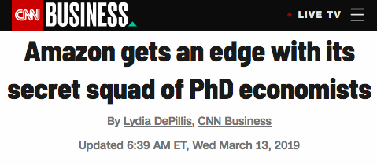
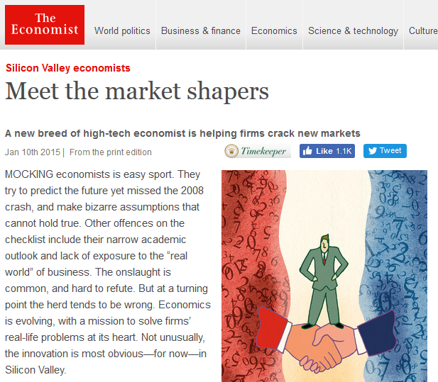
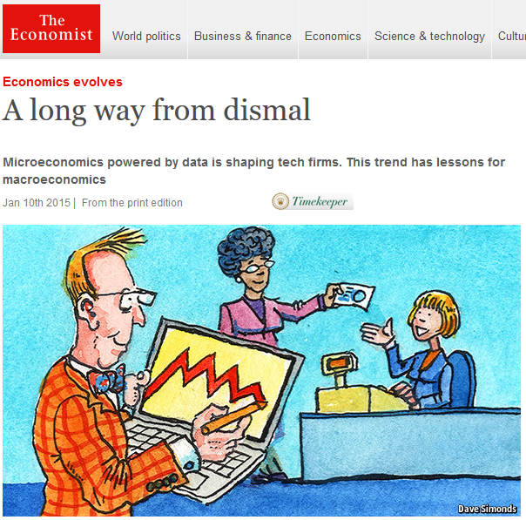
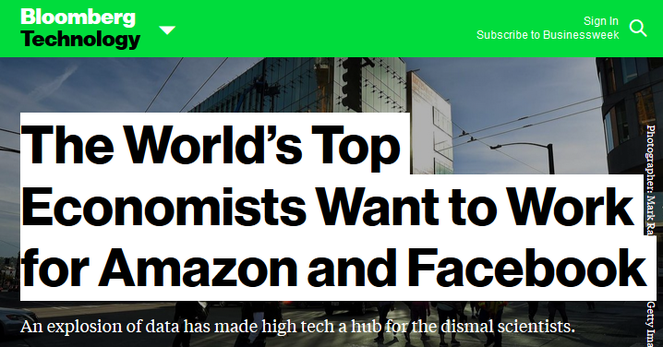

Slide 4
A Typical Day in the Life of an Economist
Meet the business team
What ambiguous problem are they trying to solve?
Work through the ambiguity and frame the question
Determine the Data and Modeling Approach
Pull and process the right data from large databases
Explore applicable econ models and/or ML techniques
Make a Product
Work with Engineers to take the model and build a product
Have a Business Impact
Guide the business on the right use the results and make them self sufficient to use the information from the product

Slide 5
Problems for Economists in Tech
Demand Estimation
New Products
Forecasting
Supply planning and optimization
Planning labor needs at different times
Improving P&Ls in Finance
Causal Inference
Effect of program changes
Effect of customer driven actions

Slide 6
Techniques used by Economists in Tech
Structural Modeling
Forecasting
Experimentation
Quasi-experimental analysis
Optimization
Machine Learning

Slide 7
Some Examples from Experience
Marketing
What is the effectiveness of our advertising channels?
How do we effectively allocate spend across different channels?
Which is the right channel for which audience?
What is the optimal messaging and targeting?
Product : Alexa
What is the long term impact of feature discover?
What is the long term impact of a negative experience?
Content optimization
What features do we roll out next?

Slide 8
Some Examples from Experience
Finance
Forecasting P&L items.
Understanding macro effects on the company’s P&L.
Understanding growth attribution to internal and external factors.
Optimization
What is the best offer to show a customer for a given product?
What is the effect on customers?
What is the effect on sellers?

Slide 9
Career Features
Independence in owning a product
Building a science team
Working with rich data
Working with people from diverse backgrounds
Having influence across different science projects
Having opportunities to work on diverse problems
Having opportunities to work on different products
Seeing your work’s impact being realized in the real world

Slide 10
To learn more:
Athey, Susan, and Michael Luca. 2019. "Economists (and Economics) in Tech Companies." Journal of Economic Perspectives, 33 (1): 209-30

